Slide 1
Music reference
Music in Libraries: Just the Basics
SEMLA Preconference Workshop
Oct. 20, 2016 – Duke University
Sara J. Beutter Manus
Music Librarian for Education and Outreach / Vanderbilt University

Slide 2
Learning objectives:
Name the questions to ask in a music reference interview.
Identify the most common formats for music materials.
Recognize the difficulties in finding songs (popular and classical) and instrumental music, and how to overcome them,
Describe components that are used in a classical music title.
Recognize the difficulties in finding world music.
Name free internet sites (and paid electronic resources like WorldCat) to use in answering music reference questions.
List basic music reference materials that your library may want to purchase.

Slide 3
What makes music reference uniquely challenging?
various formats
various instrumentation (and various terminology) of the musical work
various arrangements
various participants
various editions or performances

Slide 4
Unique challenge: common physical formats for music

Slide 5
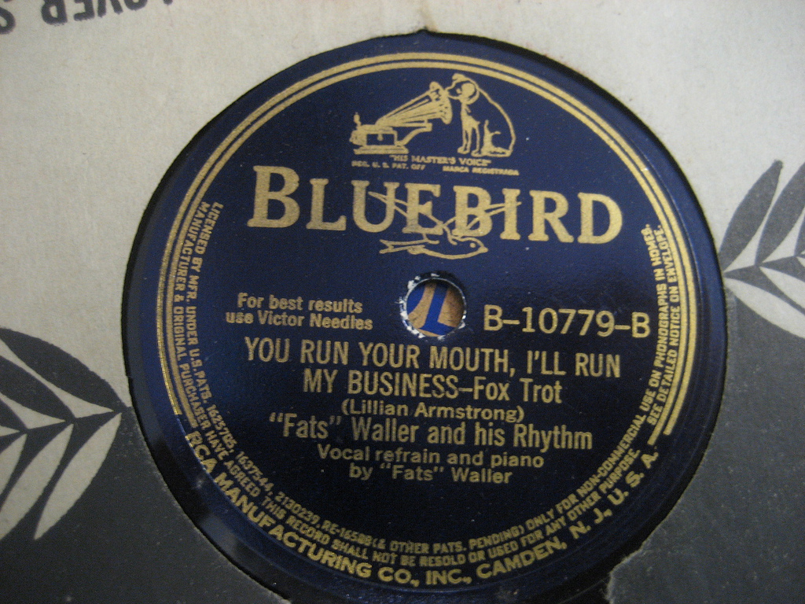
Audio formats – “records”
Variable speeds – 33 1/3, 45, and 78 rpm are the most common.
Terminology – vinyl, lps, 78s, 45s
In many cases, the only performance of a work by a specific performer or group is available on one of these formats.

Slide 6
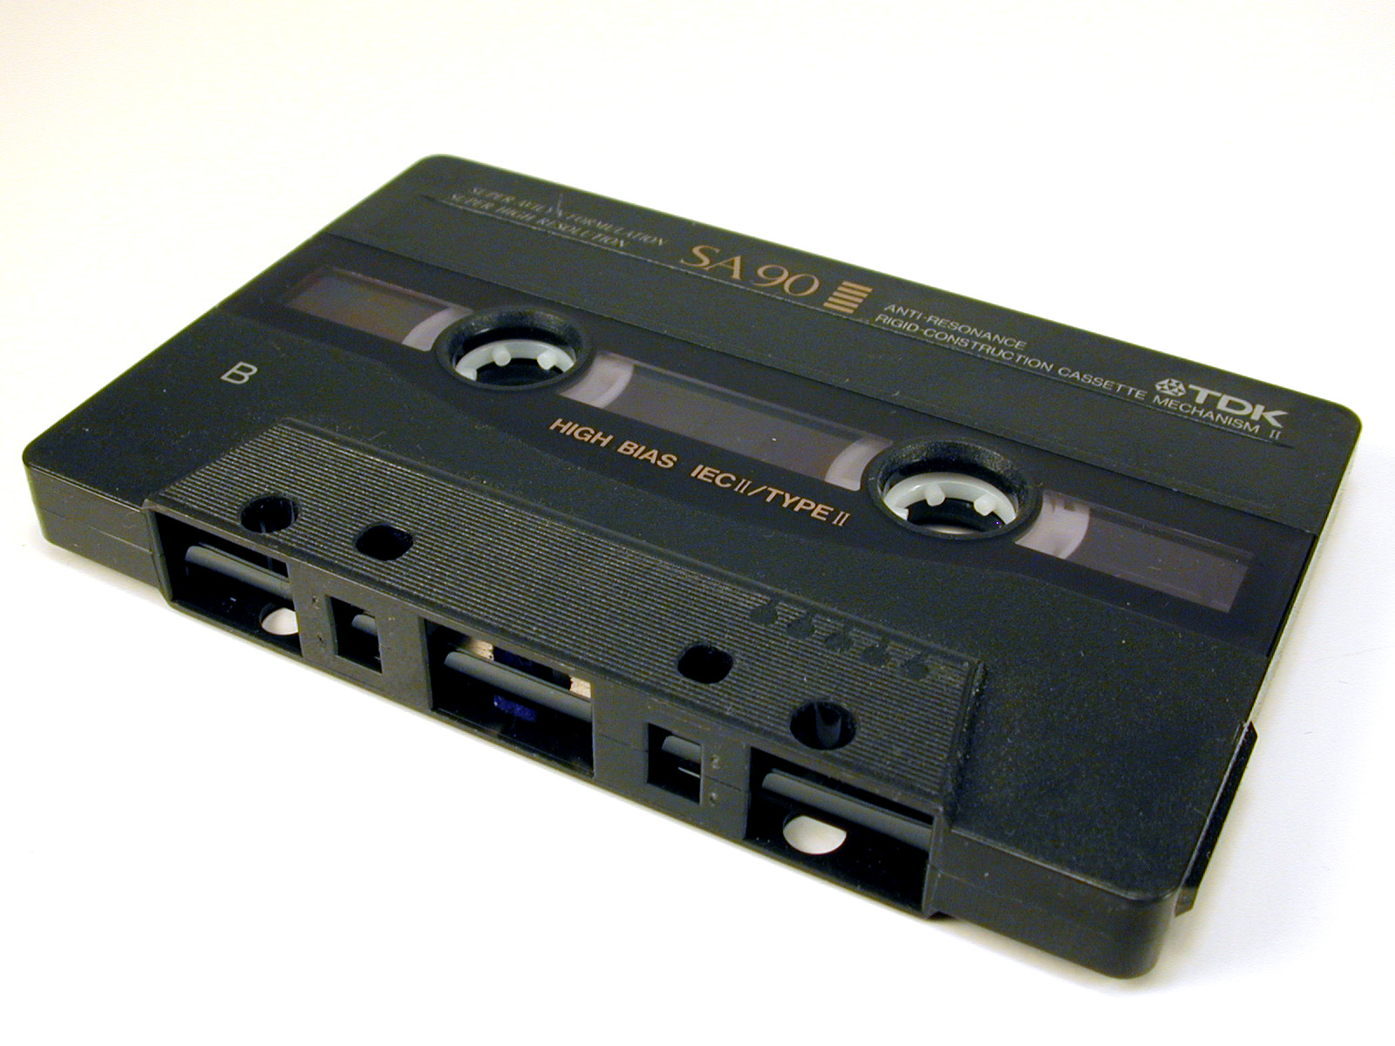
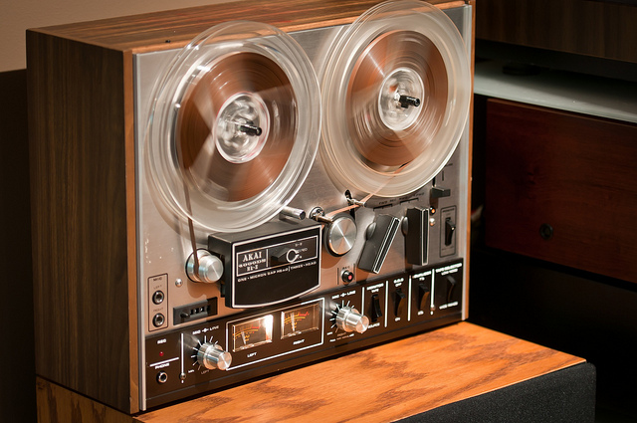
Audio formats - tapes
Cassette tape.
Reel-to-reel or open reel.

Slide 7
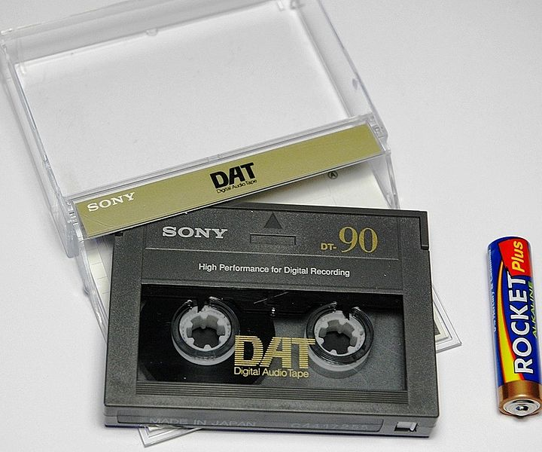
Audio formats - digital
DAT
Compact disc
Digital files (mp3, wav, wma, aif, etc.)

Slide 8
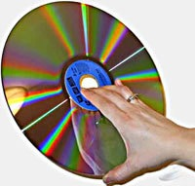
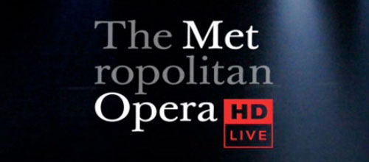
Video formats
VHS tape
Laserdisc
DVD and blu-ray
Digital files

Slide 9
The music reference interview

Slide 10
Are you looking for printed music (Score) or a recording?
The answer to this question determines which follow-up questions you will ask.
Remember that the user might need both.

Slide 11
Follow up questions if the user asks for a score:
User: I need a score to Beethoven’s Op. 127 string quartet.
Follow up: Do you need parts or a full score?
User: I need a score to Mozart’s bassoon concerto.
Follow up: Do you need a full score or the piano reduction and part?

Slide 12
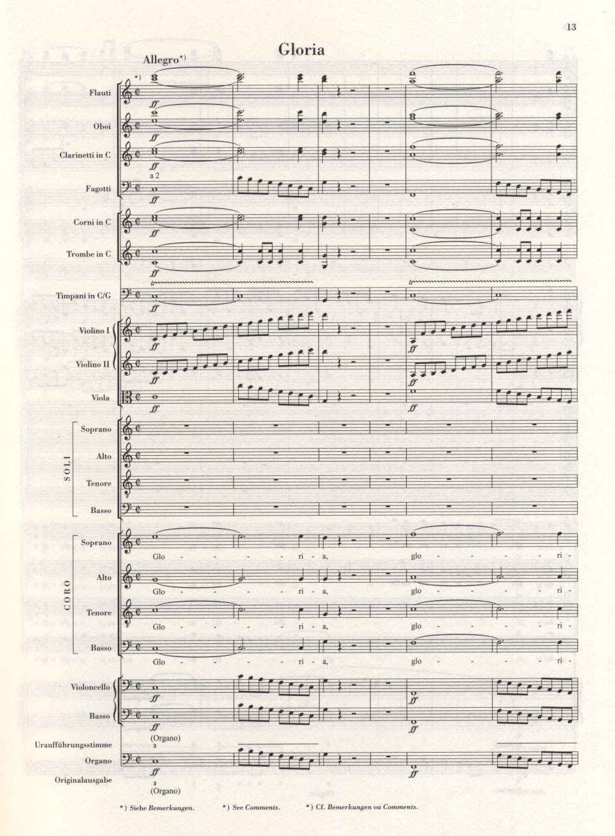
FULL SCORE
Notes:
Full score
A score in which all the parts for voices and instruments are included. Each part has its own line of music and all the lines are in vertical alignment, so that the parts may be read simultaneously. This would be the version of the printed music used by a conductor.
Miniature or study score
A full score, but usually smaller in size or print, intended for study, not for use in performance.

Slide 13
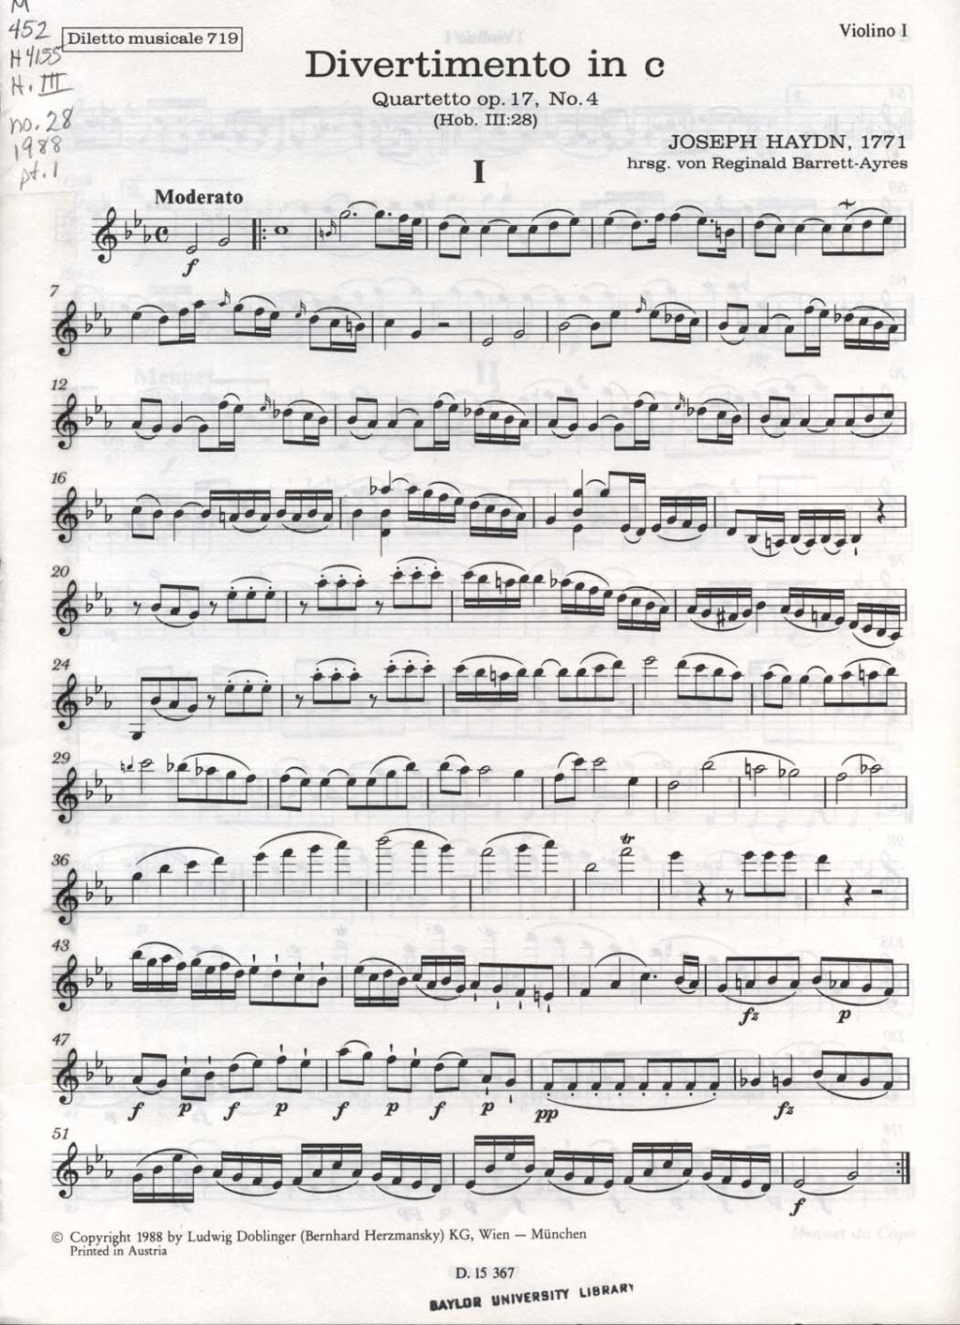
PART
Notes:
Part
The music notation for just one instrument or voice. Search keyword “part” or “parts.”

Slide 14
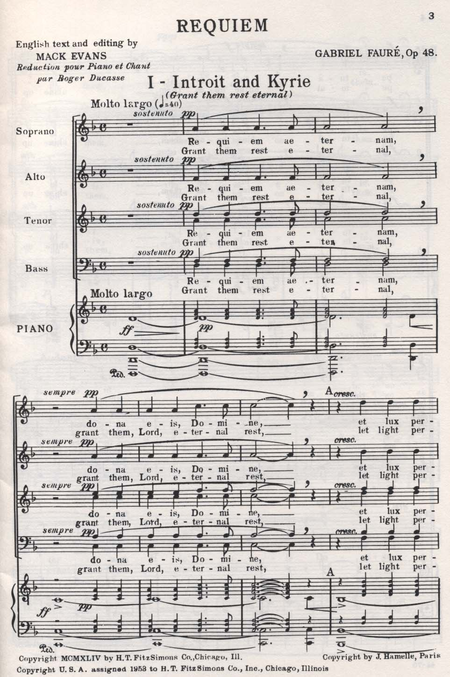
CHORAL SCORE
Notes:
Choral score
Voice parts on top. If the music includes instrumental accompaniment, a keyboard part (piano or organ usually) will appear directly below the voice parts in vertical alignment. Used for oratorios, cantatas, choral anthems, etc.

Slide 15
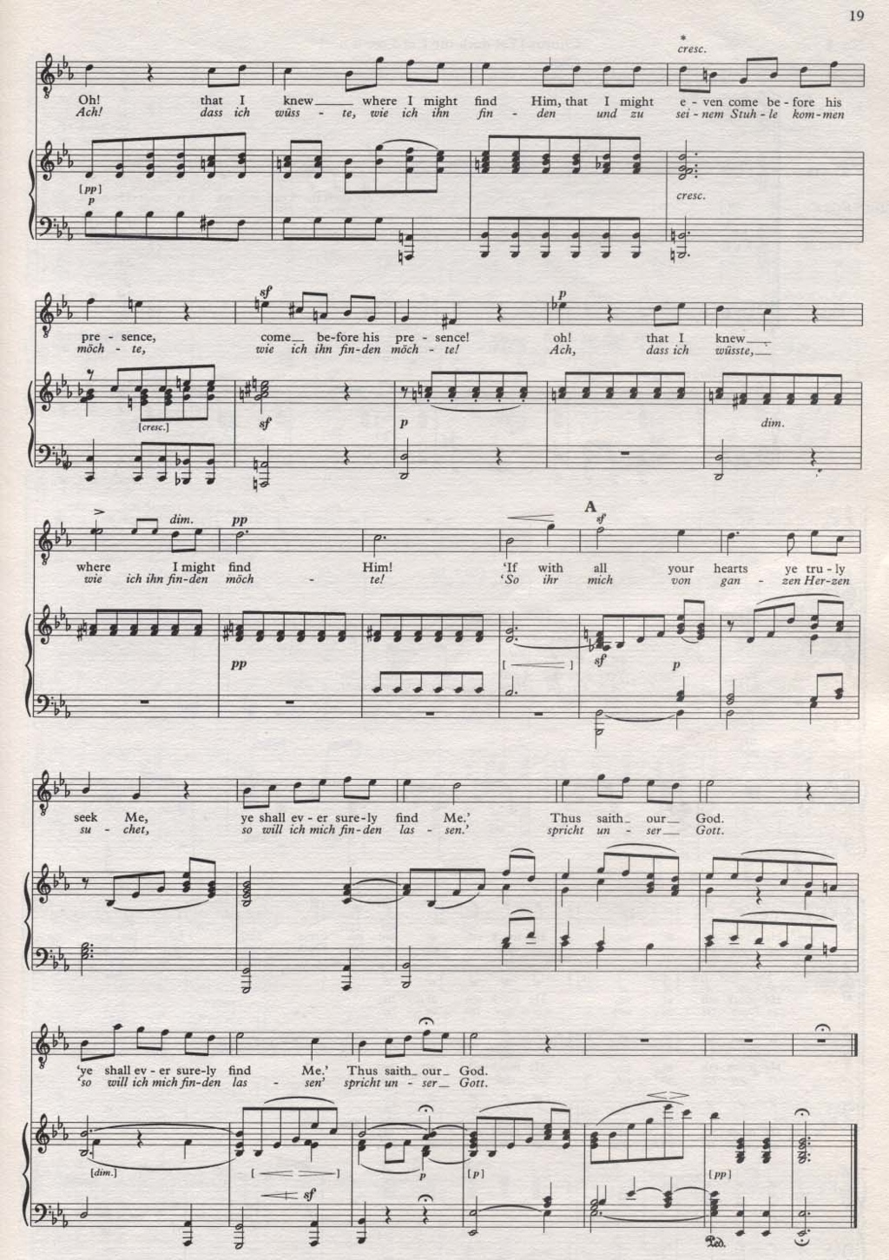
VOCAL SCORE
Notes:
Piano-vocal score / vocal score
Vocal line on top, with piano part directly below in vertical alignment. Piano part is an arrangement or reduction of the original orchestral/instrumental parts. Frequently used by singers to learn or rehearse songs from operas and musicals. Search keyword “vocal score.”

Slide 16
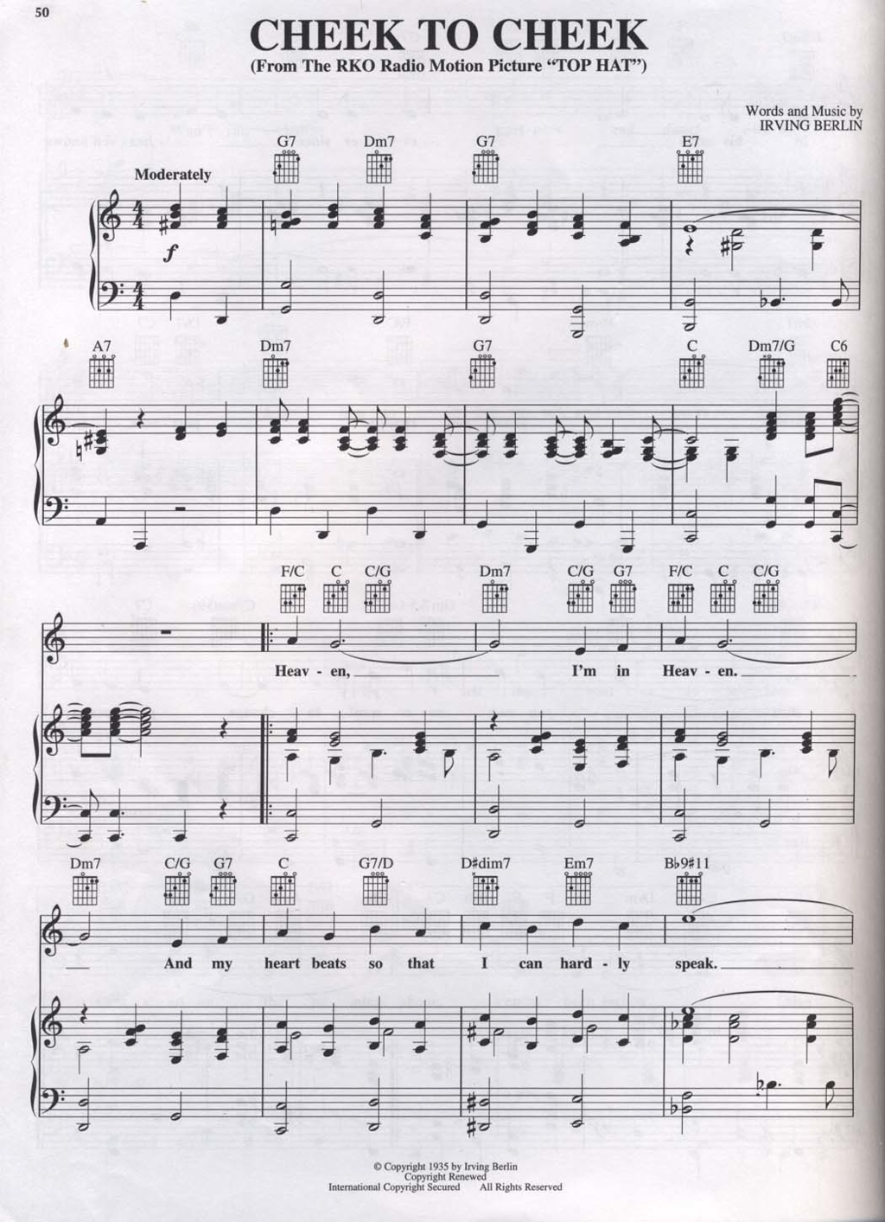
SHEET MUSIC
Notes:
Sheet Music
Vocal line on top, with piano part underneath. Often includes chord symbols above the vocal line for guitar, ukulele, etc.

Slide 17
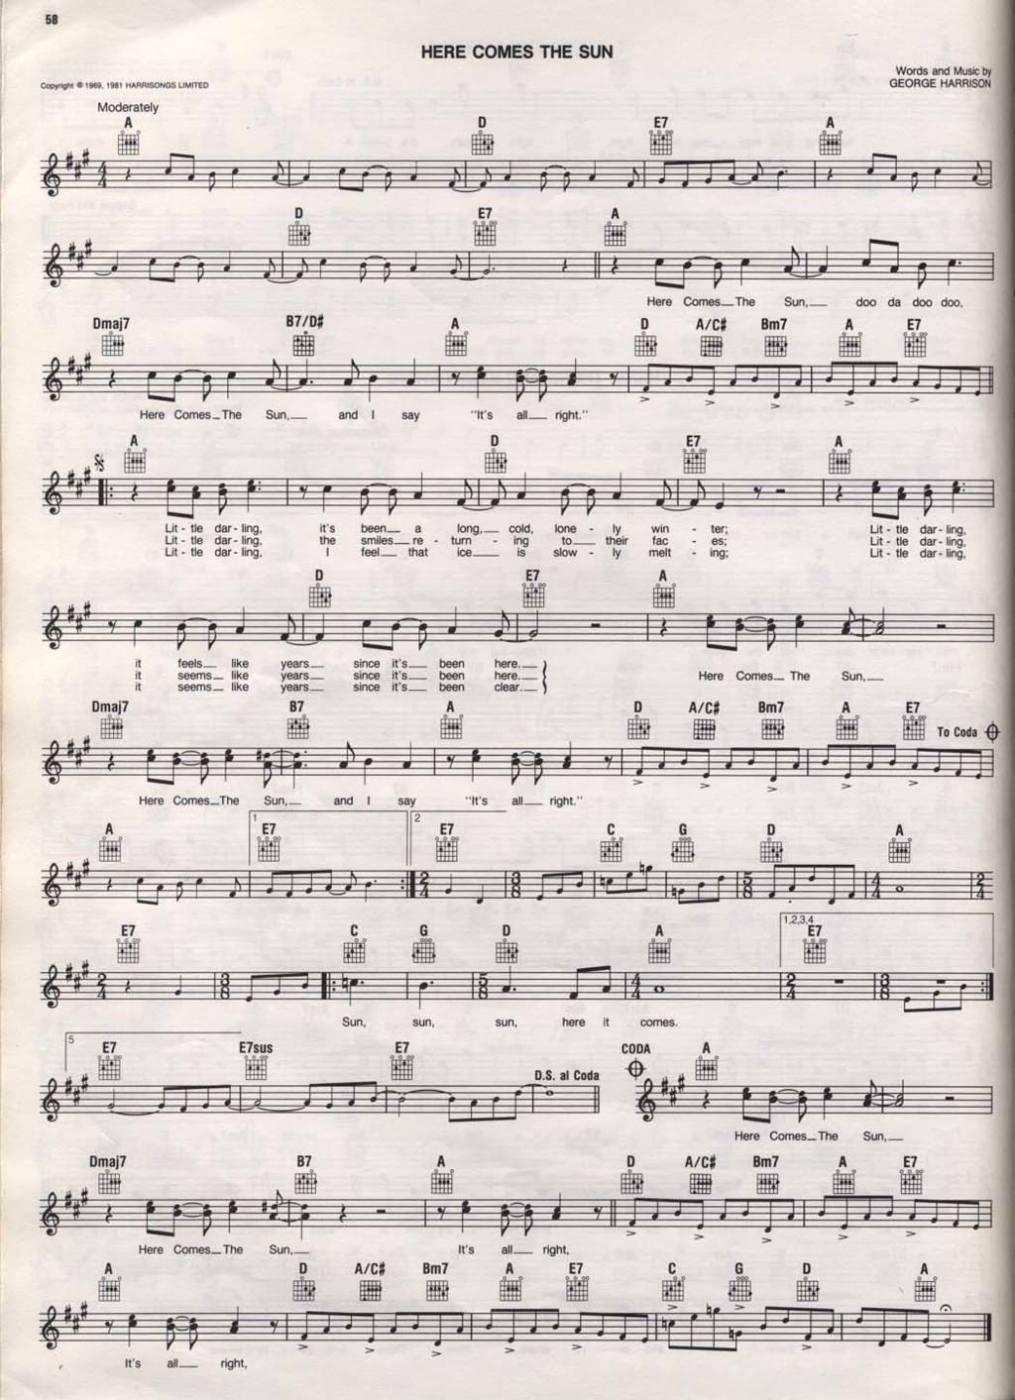
LEAD SHEET / FAKE BOOK
Notes:
Fake Book
uses a type of musical shorthand often called a lead sheet that includes the melody line with chords symbols. May contain complete or partial lyrics. Often only includes one stanza and refrain/chorus. Often used by jazz and popular music performers.

Slide 18
Follow up questions if the user asks for a recording:
You may need to ask what type of recording is needed:
User: I need a recording of Marriage of Figaro.
Follow Up: Would you prefer to listen to a sound recording, or would you like a DVD so you can watch the production?
If the recording circulates outside of the library, does the user have the appropriate playback equipment to listen or view the material at home?

Slide 19
UNIQUE CHALLENGE: INSTRUMENTATION/PERFORMING FORCES
CHORAL
ORCHESTRAL
BAND
VOCAL
INSTRUMENTAL
CHAMBER
OPERA
SOLO
SOLO
Notes:
often the type of music is determined by the instrumentation or forces used in the musical composition.

Slide 20
UNIQUE CHALLENGE: GENRE OR MUSICAL FORM
MOTET
ANTHEM
SONG
PASSION
SYMPHONY
HYMN
VOCAL
MASS
BALLET
TOCCATA
SUITE
ORATORIO
CONCERTO
ART SONG
INSTRUMENTAL
CANTATA
ARIA
PARTITA
PRELUDE
CHORALE
INVENTIONS
SONATA
Notes:
with each of these types of works there are a host of musical forms associated
to all this [click] your response might be....
but don’t worry, we’re going to help you navigate all this safely and painlessly! :-)

Slide 21
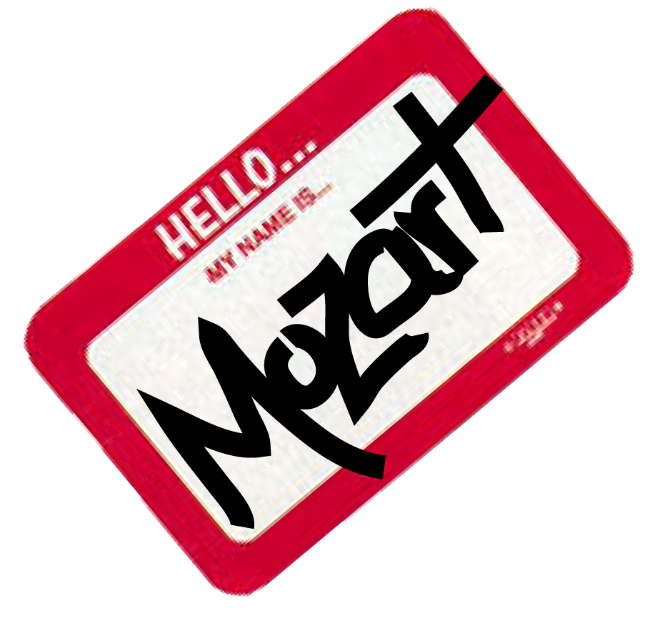
Searching the “classic” catalog for music – the basics
Use keyword searching.
Include the composer’s name and title elements as keywords.
Limit your search by format.

Slide 22
Three common problems
Musical works often lack distinct titles.
Music exists in multiple formats.
A smaller work may be part of a larger work.

Slide 23
Problem one: musical works often lack distinct titles
Solution: use the preferred title (formerly known as the uniform title).
The preferred title links multiple manifestations of the same work within the library catalog.
Used when the content is the same or similar but the wording of the title page is not.
Even when a piece of music has a distinct title, the preferred title is helpful.

Slide 24
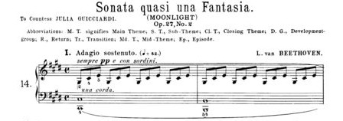
The “Moonlight” Sonata
Sonata quasi una Fantasia
Piano Sonata in C# Minor
Sonata, Opus 27, No. 2
Notes:
In addition to having generic titles, musical works present other problems for library catalogs:
Pieces may have unofficial nicknames that may not appear in catalog records. “Moonlight” sonata, “The Trout” quintet, etc.
Opera titles may be translated into different languages. The same is true for different editions of music (quatour rather than quartet; symphonien not symphonies; etc.)
This problem is solved by constructing a uniform title for each work. Uniform titles are a means of assigning an official title to a work that can be used consistently for all versions of the work throughout the catalog.

Slide 25
Formula for preferred Titles of instrumental works:
Genre (form of piece)
Medium of performance (instrumentation)
Number
Key
Notes:
If you are dealing with a work with a generic title, you can use the following formula to derive the uniform title:
Genre (form) of the piece
Instrumentation
Number (typically, opus and number, but may also include an additional number assigned by the composer).
Key signature.

Slide 26
“moonlight” sonata
Sonatas, piano, no. 14, op. 27, no. 2, C# minor
Medium of performance
Key
Genre
Number
Notes:
Here are a couple of examples of uniform titles. Marriage of Figaro’s uniform title is Nozze di figaro, because it was written in Italian. We can also see how a uniform title is constructed for a work with a generic title. While it may look intimidating, it’s actually not terribly difficult to formulate a uniform title.

Slide 27
Let’s try constructing some preferred titles…
Mozart, String Quartet in D minor, K. 421
Bach, BWV 1013, Partita for Flute in A minor
Steve Reich, Sextet for 2 pianos and percussion

Slide 28
Mozart, String Quartet in D minor, K. 421
Quartets, violins (2), viola, cello, K. 421, D minor

Slide 29
Bach, BWV 1013, Partita for Flute in A minor
Partitas, flute, BWV 1013, A minor

Slide 30
Steve Reich, Sextet for 2 pianos and percussion
Sextets, keyboard instruments (2), percussion

Slide 31
Problem two: music exists in multiple formats
Solution – limit your search format.
In “classic” catalogs, searches are typically limited in the advanced search.
In “next-gen” catalogs (discovery layers) searches are limited by facets.

Slide 32
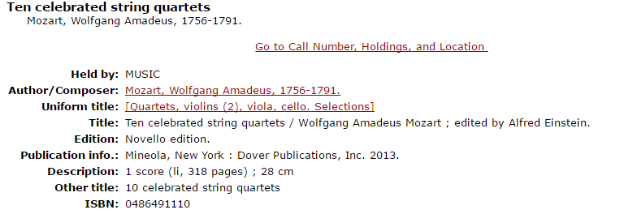
other tips for decoding a preferred title
Notes:
A few additional tips for interpreting and formulating uniform titles:
If you see “arr.” at the end of a uniform title, it means that you are looking at an arrangement. If the piece is a concerto for solo instrument and orchestra, you will see this designation for a piano reduction of the orchestral part. It also appears when a work has been arranged for different instrumentation.
Selections is used if the item features a variety of different pieces by the same composer.
Finally, if the genre word alone is the uniform title, it indicates a complete collection. For example, if the uniform title for a record with Beethoven listed as author is symphonies, all 9 symphonies are included.

Slide 33
Other tips for decoding a preferred title:

Slide 34
Problem three: a smaller work may be part of a larger work
Solution – If you can’t find the smaller part, search for the entire work.
If you can’t find a specific aria, look for the entire opera.
If you can’t find Op. 6, no. 1 individually, look for all of the Op. 6.

Slide 35
Related problem – finding a single work in a collection
Solution – Look at the contents notes for the item.
Depending on the cataloger, there me be added entries for each work in a collection.

Slide 36
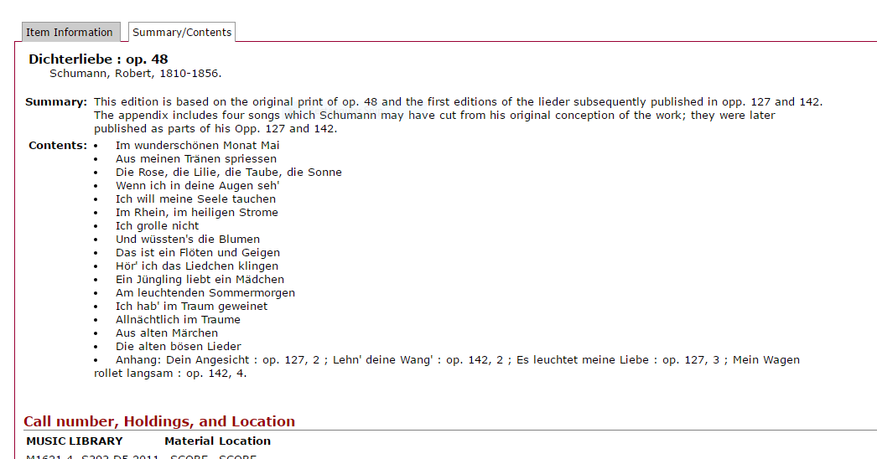

Slide 37
Need More Information on a Work?
New Grove Dictionary of Music and Musicians, 2nd ed., edited by Stanley Sadie, (New York: Oxford University Press, 2001).
The New Grove is available online as part of Oxford Music Online.
NOTEWORTHY
RESOURCES
Notes:
It is not unusual to encounter a user who has incomplete information on a work. Since it can be difficult to construct a uniform title without complete information, you may need to gather more information about the piece in question. The New Grove Dictionary of Music and Musicians is a good place to do this research. Each composer entry contains a complete list of his works that includes date of composition, genre, opus, and key signature.

Slide 38
Need to browse? Use lc subject headings

Slide 39
Subject Headings By:
Type of Music Folk music, Jazz, Popular music, New age music
Type of Musician Composers, Conductors (Music), Jazz Musicians, Singers
Geographic Region Music Africa, Music India, Music United States
Time Period Music 15th Century, Music 17th Century
Notes:
In addition to form/genre headings, there are additional subject headings that can be used for searching:
Type of music – usually refers to “popular” music rather than “classical” music.
Type of musician – this can aid in research
Geographic region – for those interested in music from a specific area
Time period.

Slide 40
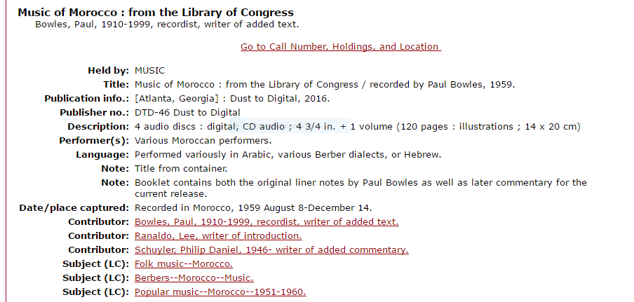

Slide 41
Finding Works in Anthologies:
Title keyword search in local catalog or WorldCat
Broaden to genre + composer name
Read the contents notes carefully – individual pieces are often indexed here.
Song indexes:
Sears, Song Index and Supplement
Ferguson, Song Finder (indexes popular songs by title)
De Charms, Songs in Collections

Slide 42
Reference Sources:
Dictionaries & Encyclopedias:
New Grove Dictionary of Music & Musicians (available in print or online as part of Oxford Music Online)
New Harvard Dictionary of Music
Garland Encyclopedia of World Music (print or online)
Thematic catalogs
Guides to research – bibliographies of composers, genres, instruments, etc.
Discographies – lists of recordings

Slide 43
Reference Sources:
Song indexes
Directories:
Musical America (festivals, agents, schools of music, etc.)
Music databases – available by subscription:
Music Periodicals Database (formerly known as IIMP)
RILM Abstracts
Music Index
JSTOR

Slide 44
Recommended Free Online Sources:
Allmusic.com
WorldCat.org
Petrucci Music Library/IMSLP

Slide 45
Where can I go for more help?
Ask me! Sara Manus, sara.manus@Vanderbilt.edu
Music specialists in your area (city, state, or region)
Music Library Association regional chapters – SEMLA covers North Carolina.
Association listservs, like MLA-L.

Slide 46
Access the PowerPoint slides and links to various resources on my Research Guide, http://researchguides.library.vanderbilt.edu/semla_reference_2016.
Sara J. Beutter Manus, Vanderbilt University, Anne Potter Wilson Music Library, (615) 322-8686, sara.manus@Vanderbilt.edu.

