Slide 1
Cataloging Video Recordings in RDA Southeast Music Library Association (SEMLA) October 20, 2016 Durham, NC
Dr. Sonia Archer-Capuzzo
smarcherdma@gmail.com

Slide 2
Relationships
Image from vivianswiftblog.com

Slide 3
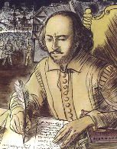
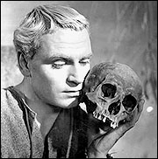
People, Corporate bodies, Families
1xx: Must be the creator of the work (like an author), not simply a performer of the work (like an actor)
7xx: All other contributors, related works
Name authority files (http://id.loc.gov/, authorities.loc.gov, OCLC Connexion & Browser)
Relationship designators
RDA Toolkit, Appendix I: Relationships between a Resource and Persons/Families/Corporate Bodies
RDA Toolkit, Appendix J: Relationships between Works, Expressions, Manifestations, and Items
100 field
700 field
Images from annoyzview.wordpress.com and www.factmonster.com

Slide 4
Contents notes
505: consider providing an enhanced contents note (indicators 00, using delimiters for differentiate authors, titles, and other info) to differentiate each work within the collection
505 00 $t Let’s face the music and dance / $r Irving Berlin -- $t Devil may care / $r Bob Dorough -- $t Let’s fall in love / $r Ted Koehler, $r Harold Arien -- $t When I look in your eyes / $r Leslie Bricusse -- $t Popsicle toes / $r Michael Franks -- $t I’ve got you under my skin / $r Cole Porter -- $t I can’t give you anything but love / $r Jimmy McHugh, $r Dorothy Fields -- $t I’ll string along with you / $r Harry Warren, $r Al Dubin -- $t East of the sun (and west of the moon) / $r Brooks Bowman -- $t Pick yourself up / $r Jerome Kern, $r Dorothy Fields -- $t The best thing for you / $r Irving Berlin -- $t Do it again / $r George Gershwin, $r B.G. DeSylva -- $t Why should I care.

Slide 5
Relationships
505 0_ Let’s face the music and dance / Irving Berlin -- Devil may care / Bob Dorough -- Let’s fall in love / Ted Koehler, Harold Arien -- When I look in your eyes / Leslie Bricusse -- Popsicle toes / Michael Franks -- I’ve got you under my skin / Cole Porter -- I can’t give you anything but love / Jimmy McHugh, Dorothy Fields -- I’ll string along with you / Harry Warren, Al Dubin -- East of the sun (and west of the moon) / Brooks Bowman -- Pick yourself up / Jerome Kern, Dorothy Fields -- The best thing for you / Irving Berlin -- Do it again / George Gershwin, B.G. DeSylva -- Bonus track: Why should I care.
700 1_ Krall, Diana, $e performer, $e arranger of music.
700 1_ LiPuma, Tommy, $e producer.
700 1_ Mandel, Johnny, $e arranger of music.
700 1_ Malone, Russell, $e performer.
etc.
700 12 $i Container of (work): $a Berlin, Irving, $d 1888-1989. $t Follow the fleet. $p Let’s face the music and dance.
700 12 $i Container of (work): $a Dorough, Bob. $t Devil may care.
etc.

Slide 6
Relationships
505 00 $t Let’s face the music and dance / $r Irving Berlin -- $t Devil may care / $r Bob Dorough -- $t Let’s fall in love / $r Ted Koehler, $r Harold Arien -- $t When I look in your eyes / $r Leslie Bricusse -- $t Popsicle toes / $r Michael Franks -- $t I’ve got you under my skin / $r Cole Porter -- $t I can’t give you anything but love / $r Jimmy McHugh, $r Dorothy Fields -- $t I’ll string along with you / $r Harry Warren, $r Al Dubin -- $t East of the sun (and west of the moon) / $r Brooks Bowman -- $t Pick yourself up / $r Jerome Kern, $r Dorothy Fields -- $t The best thing for you / $r Irving Berlin -- $t Do it again / $r George Gershwin, $r B.G. DeSylva -- $g Bonus track: $t Why should I care.
700 1_ Krall, Diana, $e performer, $e arranger of music.
700 1_ LiPuma, Tommy, $e producer.
700 1_ Mandel, Johnny, $e arranger of music.
700 1_ Malone, Russell, $e performer.
etc.

Slide 7
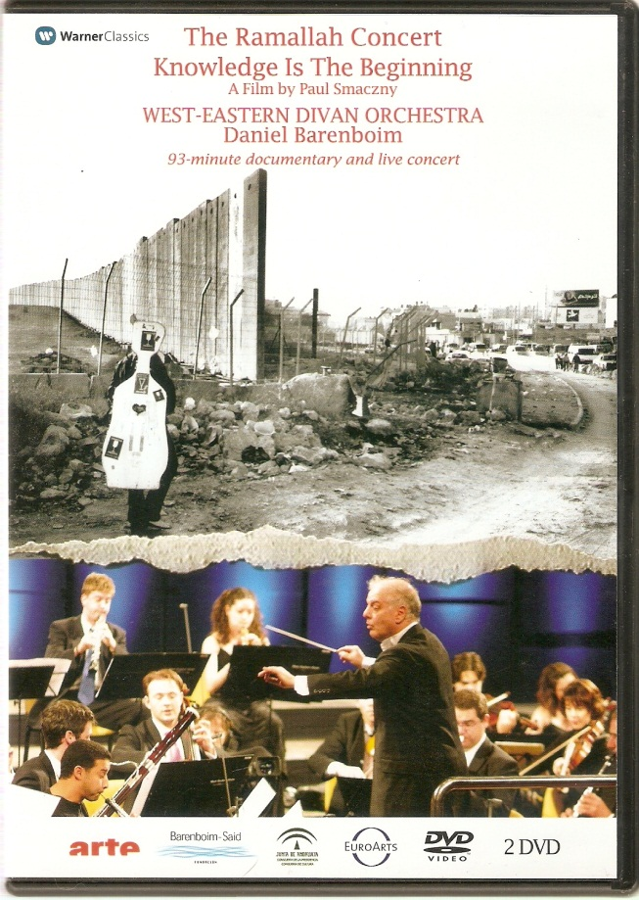
Video Recordings

Slide 8
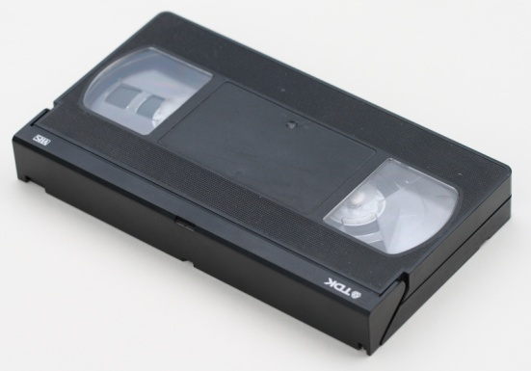
Video Formats
DVD: Digital versatile disk
Introduced in U.S. in 1997
Blu-Ray and HD DVD introduced in U.S. in 2006
“Format war” of 2006-2008, Blu-Ray won
VHS: Video home system
1977: first commercially available VHS-based VCRs sold in US
Won format war with Betamax in late 1970s-early 1980s
Streaming video
Content sent in compressed form over the Internet and displayed by the viewer in real time
Images from commons.wikimedia.org, pixabay.com

Slide 9
Input a new record
Black & white vs. color
Sound vs. silent
Significantly different lengths
Different machine/video recording format (VHS vs. DVD)
Change in publication date
Unless changes are just for container
Dubbed vs. subtitles
Different language version

Slide 10
Don’t input a new record
Changes in dates that are only for the container
Ex: ©2010. Packaging design ©2011.
Absence or presence of multiple publishers, distributors, and/or manufacturers as long as one on the resource matches one on the record
Ex:
On item: Arte, Barenboim-Said Foundation, EuroArts, Junta de Andalucia, Warner Classics
On record: Warner Classics
Absence or presence of a publisher number

Slide 11
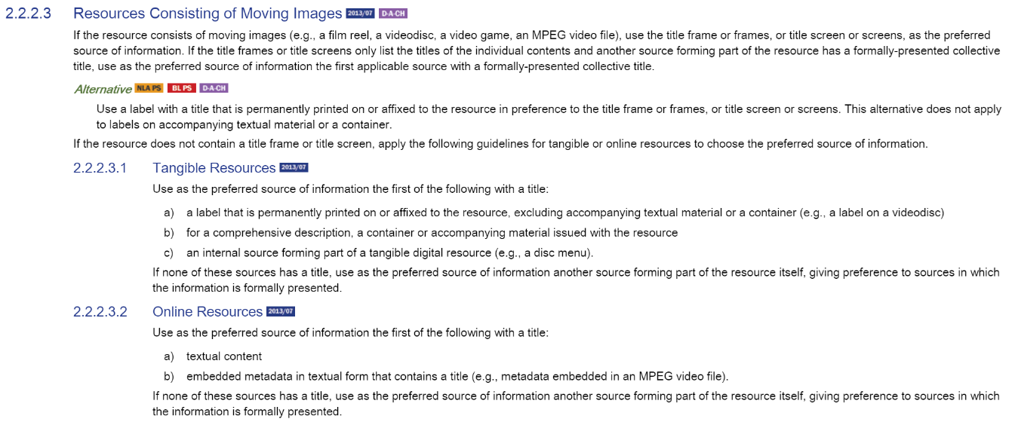
Preferred source of information
Image from RDA Toolkit

Slide 12
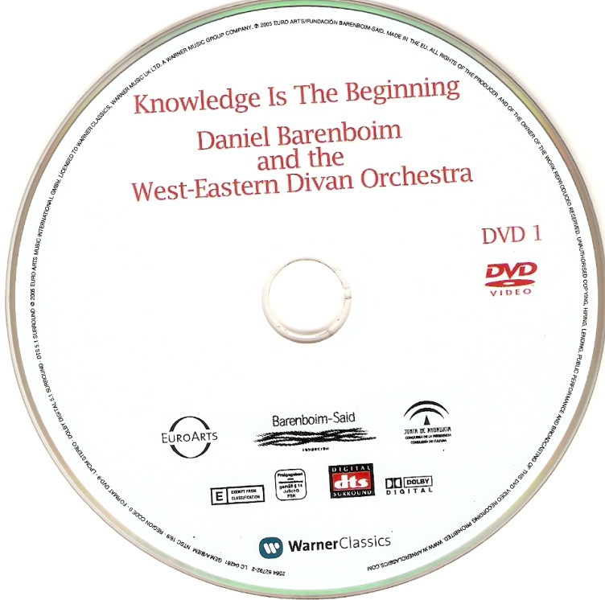
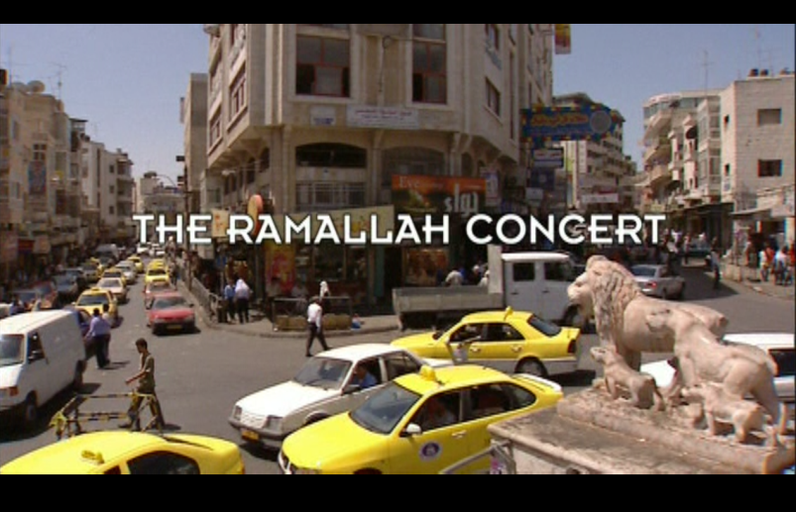
Preferred source of information
Title frame(s)/screen(s)
Label on resource (Alternative preferred source)

Slide 13
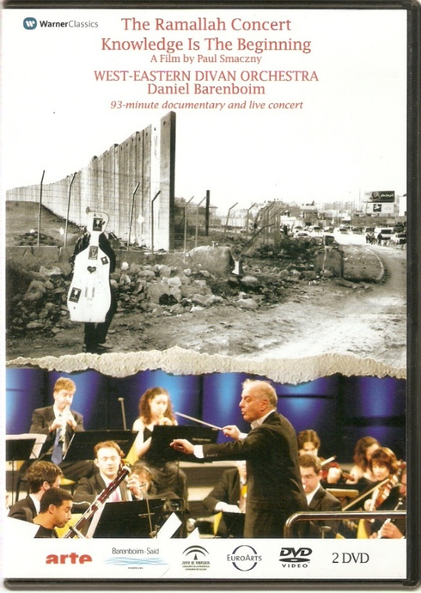
Preferred source of information
Container or accompanying material
Internal source, like disc menu

Slide 14
Title Proper
Core
Take what you see, but…
Do not include introductory words or phrases, like “Disney presents”
Put information about where you got the title in a 500 note if it didn’t come from the title frames.
Examples:
Title from container.
Title from menu screen.
Title from disc label.

Slide 15
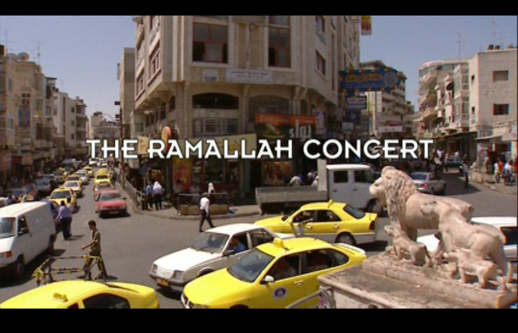
Title
245 00 Knowledge is the beginning ; $b The Ramallah concert

Slide 16
Other titles
740: Uncontrolled Related/Analytical Title
Use field 740 for the title portion of a related work that would normally be entered under a name/title heading in catalog entry form. In records for collections lacking a collective title, use field 740 also for titles recorded in field 245 subsequent to the first title.
245 00 Knowledge is the beginning ; $b The Ramallah concert
740 41 The Ramallah concert.

Slide 17
Statement of responsibility
Core
A statement of responsibility▼ is a statement relating to the identification and/or function of any persons, families, or corporate bodies responsible for the creation of, or contributing to the realization of, the intellectual or artistic content of a resource.
“Generally record work-level roles (e.g., creator and individuals or groups associated with a work from RDA Appendix I) in the statement of responsibility. Use cataloger’s judgment to determine the significance of their involvement in the creation of artistic and intellectual content or the work being cataloged” (OLAC Best Practices, p. 72).
100: reserved for the person responsible for creation (not likely for video recordings)
245 $c: cataloger’s judgment
5xx and 7xx: for all other contributors
Director, producer
Performer
Composer

Slide 18
Many Creators & Contributors
245 00 Die Meistersinger von Nürnberg / $c music by Richard Wagner ; presented by Unitel Classica ; Salzburg Festival, from the Grosses Festspielhaus ; producer, Magdalena Herbst ; directed by Hannes Rossacher.
508 __ Stage director, Stefan Herheim ; editor, Heidi Reuscher ; set designer, Heike Scheele ; lighting designer, Olaf Freese ; costume designer, Vestine Völlm ; dramatic advisor, Alexander Meier-Dörzenbach ; video director, Hannes Rossacher ; camera, Alexander Rüiimkorf.
511 1_ Michael Volle (Hans Sachs) ; Roberto Saccà (Walther von Stolzing) ; Anna Gabler (Eva) ; Peter Sonn (David) ; Georg Zeppenfeld (Veit Pogner) ; Monika Bohinec (Magdalene) ; Markus Werba (Sixtus Beckmesser) ; Thomas Ebenstein (Kunz Vogelgesang) ; Guido Jentjens (Konrad Nachtigall) ; Oliver Zwarg (Fritz Kothner ) ; Benedikt Kobel (Balthasar Zorn) ; Franz Supper (Ulrich Eisslinger) ; Thorsten Scharnke (Augustin Moser) ; Karl Huml (Hermann Ortel) ; Lehrbuben Akademie Meistersinger of the Young Singers Project ; Konzertvereinigung Wiener Staatsopernchor ; Ernst Raffelsberger, chorus master ; Wiener Philharmoniker ; Daniele Gatti, conductor.

Slide 19
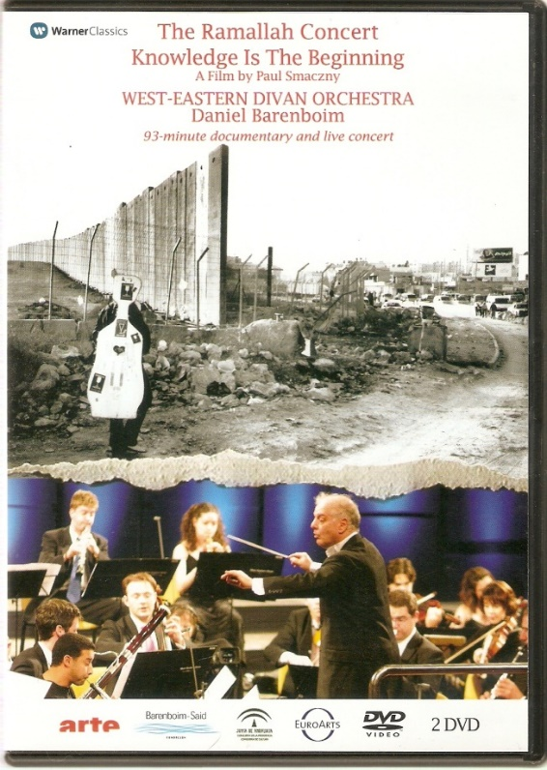
Statement of Responsibility
245 0 0 Knowledge is the beginning ; $b The Ramallah concert / $c a film by Paul Smaczny ; EuroArts Music ; Barenboim- Said Fundación ; Junta de Andalucia Consejería de la Presidencia, Consejería de Cultura ; Warner Classics ; Arte.

Slide 20
Authorized Access Point
Core
Is there a creator??
100 for person
110 for corporate body
More likely scenario: no one creator
Is there a preferred title for the work??
130 for title access point
130 _0 Sherlock (Television program: 2010-)

Slide 21
Other Important Creators/Contributors
7XX fields
Authorized access points to correspond to creators and/or contributors listed in the record (245, 508, 511)
700 1_ Barenboim, Daniel, $d 1942-, $e conductor.
700 1_ Said, Edward W.
700 1_ Smaczny, Paul, $e producer.
etc.
700 12 $i Container of (work) : $a Mozart, Wolfgang Amadeus, $d 1756-1791. $t Sinfonie concertanti, $m oboe, clarinet, horn, bassoon, orchestra, $n K. Anh. 9, $r E♭ major.
etc.
710 2_ EuroArts Music International GmbH.
710 1_ Andalusia (Spain). $b Consejería de Cultura.

Slide 22
Edition and Series Statements
Edition Statement Examples
Series Statement Examples
250 __ Director’s extended cut.
250 __ 50th anniversary edition.
250 __ Four-disc special edition.
250 __ Widescreen edition.
830 _0 Mannes College of Music Concerts.
830 _0 Essential concerts.
830 _0 Disney Blu-ray.
830 _0 Ultimate edition.
Make sure you include a 490 field to transcribe the series states, too.

Slide 23
Production, etc., Information
Dates in the fixed fields +
264 _0 Production statement
264 _1 Publication statement
264 _2 Distribution statement
264 _3 Manufacture statement
264 _4 Copyright date

Slide 24
Publication Information
Core
Who’s the publisher?
Many names may appear on the resource.
The production company is not always the publisher of the manifestation.
Subsidiaries of the production company may be listed.
The distributor may be listed.
“If there is doubt as to whether a person, corporate body or family is functioning as a publisher or distributor, treat the name as a publisher” (OLAC Best Practices).
Where’s the publisher?
Sometimes you have to look outside the resource
What’s the date?
Read the statements before and after each date to be sure you pick the right one.

Slide 25
So many dates!

Slide 26
Publication and Copyright
Core
264 _1 UK : $b Warner Classics, $c [2005]
264 _4 $c ℗2005

Slide 27
Physical Description
Core
300 $a: 1 videodisc (Playing time)
300 $b: sound and color content
300 $c: 4 3/4 in.
Repeatable 300
300 __ 2 videodiscs (205 min.) : $b sound, color ; $c 4 3/4 in. + $e 1 booklet (37 pages : illustrations (some color) ; 18 cm)
OR
300 __ 2 videodiscs (205 min.) : $b sound, color ; $c 4 3/4 in.
300 __ 1 booklet (37 pages) : $b illustrations (some color) ; $c 18 cm

Slide 28
Content, Media, Carrier Types
Core
336 __ two-dimensional moving image $b tdi $2 rdacontent $3 videodiscs
336 __ performed music $b prm $2 rdacontent $3 videodiscs
336 __ text $b txt $2 rdacontent $3 booklet
337 __ video $b v $2 rdamedia $3 videodiscs
337 __ unmediated $b n $2 rdamedia $3 booklet
338 __ videodisc $b vd $2 rdacarrier $3 videodiscs
338 __ volume $b nc $2 rdacarrier $3 booklet
Notes:
For our example

Slide 29
Sound Characteristics
344 field
$a = Type of recording: digital
$b = Recording medium: optical
$g = Configuration of playback channels: mono, stereo, surround
$h = Special playback characteristics: Dolby digital, LCPM
Image from: pixabay.com

Slide 30
Video Characteristics
346 field
$a = Video format (only for analog recordings): VHS, Beta-cam, Laser disc
$b = Broadcast standard (television broadcast formatting): PAL, NTSC
Image from: www.flickr.com

Slide 31
Digital File Characteristics
347 field
$a = File type: video file
$b = Encoding format: Blu-ray, DVD video
$e = Regional encoding: region 4, all regions
Image from: pixabay.com

Slide 32
Form of Work
380 field
Class or genre to which the resource belongs: “motion picture,” “television program” most commonly used
OLAC recommends using a controlled vocabulary, like LCGFT (in which case, just use a 655 genre/form heading ☺)

Slide 33
344 __ digital $b optical $g stereo $g surround $h LCPM Stereo $h Dolby Digital 5.1 $2 rda
346 __ $b NTSC $2 rda
347 __ video file $b DVD video $e region 0 $2 rda

Slide 34
Aspect Ratio
500 field
Full screen, wide screen, or mixed
Ratio with a denominator of 1
4:3 = 1.33:1, 16:9 = 1.78:1
500 __ Widescreen (1.78:1).

Slide 35
Equipment or System Requirements
538 field: Used to be a catch-all for the information now encoded in the 34X fields
Now use for information about the encoding format (Recordable DVD, DVD-ROM) or other important system information that might have been left out earlier

Slide 36
Contributors
508: Creation/Production Credits
Producer, director, editor, etc.
511: Performer, Narrator, etc.
Instrumentalist, actor, participant, narrator, etc.
508 __ Producer, director, Paul Smaczny ; Concert director, Michael Beyer ; Documentary director, Ayellet Heller.
511 0_ West-Eastern Divan Orchestra ; Daniel Barenboim, conductor ; Edward Said.

Slide 37
Cast as Contributors
511 1_ Benedict Cumberbatch, Martin Freeman, Rupert Graves.
In catalog:
Cast: Benedict Cumberbatch, Martin Freeman, Rupert Graves.

Slide 38
Duration
300 $a + 306 + 500
300 __ 2 videodiscs (205 min.)
306 __ 013300 $a 015200
500 __ Duration: 93 min. (documentary) ; 112 min. (concert).

Slide 39
Summary & Target Audience
520: Summary
“Use for an abstract, annotation, review, summary, or a phrase describing the material.”
521: Target Audience
“Use primarily when the contents of an item are considered appropriate for a specific audience or intellectual level.”
520 __ “Daniel Barenboim established the West-Eastern Divan Orchestra with the late Palestinian writer Edward Said in order to bring together young musicians from across the political divide in the Middle East. Their hope was that music would heal and help to bring understanding and tolerance of different beliefs and cultures.” -- Container.

Slide 40
Other 500 notes
For nature and form
Opera in 3 acts.
Rock music.
Sonatas for cello and piano.
Edition and history
Remake of a 1950 motion picture by the same name.
Reissue.
Accompanying material
Libretto in container.
Synopsis in accompanying booklet.

Slide 41
Numbers & Codes
Fixed fields (selected)
007
020
024
028
033
041

Slide 42
Fixed Fields
Type (Leader/06)
g = Projected medium
Lang (008:35-37)
eng = English
Time (VIS:008/18-20; 006/01-03)
205 = total time in minutes
Ctry (008/15-17)
xxk = somewhere in the UK
Desc (Leader/18)
i = ISBD
Tmat (VIS:008/33; 006/16)
v = Videorecording
Tech (VIS:008/34; 006/17)
l = Live action
DtSt (008/06)
t = Publication & copyright dates

Slide 43
007
$a = material category v = videorecording
$b = material designation d = videodisc
$d = color b = black & white
c = multicolored
m = mixed
$e = video format s = Blu-ray
v = DVD
$f = sound a = sound on medium
$g = medium of sound i = videodisc
$h = dimensions z = other
$i = playback channels k = mixed
m = mono q = multi, surround, quad
s = stereo
u = unknown
Notes:
The 007 field for videos is fortunately a little shorter than that for audio recordings.

Slide 44
007
007 __ v $b d $d c $e v $f a $g i $h z $i k

Slide 45
Identifiers of Manifestation
Core
020: ISBN
Transcribe as you would from a book
024: Other standard identifier
ISRC
UPC
EAN
028: Publisher number
020 __ Number
024 0_ Number
024 1_ Number
024 3_ Number
028 42 Number $b Publisher

Slide 46
Identifier of Manifestation
024 1_ 825646279227
028 42 2564 62792-2 $b Warner Classics
028 42 LC 04281 $b Warner Classics

Slide 47
Date/Time & Place of Event
033 + 518
033 ## yyyymmddhhmm $b geographic code $c subarea code $p place
033 00 201310012000 $b 3804 $c N4 $p Carnegie Hall
Capture
New York State
Single date
New York City
8:00 PM, October 1, 2013

Slide 48
Date/Time & Place of Event
033 + 518
518
$a: All information can go here, or…
$d: Date of event: yr. mo. day
$o: Other event information
$p: Place of event
033 00 $3 DVD 2 (concert) $a 20050821 $b 7507 $c R28 $p Cultural Palace
518 __ $3 DVD 2 (concert) : $o Recorded live $d 2005 August 21 $p Cultural Palace in Ramallah.

Slide 49
Language & Accessibility
Fixed fields + 041 + 546
Do not code for languages of special features, credits, packaging
Languages of accompanying materials may be noted and coded depending on their importance in the cataloger’s judgment.
Can include information about spoken and/or sung language(s), dubbing, captions, subtitles
Include information about subtitles, subtitles for the deaf and hard-of-hearing (SDH), audio enhancement for the visually impaired

Slide 50
Language
041 1_ eng $j eng $j fre $j ger $j spa $j ara $g eng $g fre $g ger $g spa
546 __ Subtitles in English, French, German, Spanish, and Arabic.
546 __ Booklet includes performance notes and introductory material in English, French, German, and Spanish.

Slide 51
Putting it all together
Image from theaffordablemouse.com

Slide 52
007 v $b d $d c $e v $f a $g i $h z $i k
040 ___ $b eng $e rda $c ___
024 10 825646279227
028 42 2564 62792-2 $b Warner Classics
028 42 LC 04281 $b Warner Classics
033 00 $3 DVD 2 (concert) $a 20050821 $b 7507 $c R28 $p Cultural Palace
041 1 eng $j eng $j fre $j ger $j spa $j ara $g eng $g fre $g ger $g spa
245 00 Knowledge is the beginning ; $b The Ramallah concert / $c a film by Paul Smaczny ; EuroArts Music ; Barenboim-Said Fundación ; Junta de Andalucia Consejería de la Presidencia, Consejería de Cultura ; Warner Classics ; Arte.
264 1 UK : $b Warner Classics, $c [2005]
264 4 $c ℗2005
300 2 videodiscs (205 min.) : $b sound, color ; $c 4 3/4 in.
300 1 booklet (37 pages) : $b illustrations (some color) ; 18 cm
306 015200 $a 013300
336 two-dimensional moving image $b tdi $2 rdacontent $3 videodiscs
336 text $b txt $2 rdacontent $3 booklet
337 video $b v $2 rdamedia $3 videodiscs
337 unmediated $b n $2 rdamedia $3 booklet
338 videodisc $b vd $2 rdacarrier $3 videodiscs
338 volume $b nc $2 rdacarrier $3 booklet

Slide 53
344 digital $b optical $g stereo $g surround $h LCPM Stereo $h Dolby Digital 5.1 $2 rda
346 $b NTSC $2 rda
347 video file $b DVD video $e region 0 $2 rda
500 Widescreen (1.78:1).
500 Duration: 93 minutes (documentary), 112 minutes (concert).
505 00 $g Videodisc 2: $t The Ramallah concert. $t Sinfonia concertante in E flat major for oboe, clarinet, bassoon and horn, K Anh. 9 (297b) / $r Wolfgang Amadeus Mozart -- $t Symphony no. 5 in C minor, op. 67 / $r Ludwig van Beethoven -- $t Nimrod from Enigma Variations, op. 36 / $r Edward Elgar.
508 Producer, director, Paul Smaczny ; Concert director, Michael Beyer ; Documentary director, Ayellet Heller.
511 0 West-Eastern Divan Orchestra ; Daniel Barenboim, conductor ; Edward Said.
518 $3 Videodisc 2 (The Ramallah concert) : $o Recorded live $d 2005 August 21 $p Cultural Palace in Ramallah.
520 “Daniel Barenboim established the West-Eastern Divan Orchestra with the late Palestinian writer Edward Said in order to bring together young musicians from across the political divide in the Middle East. Their hope was that music would heal and help to bring understanding and tolerance of different beliefs and cultures.” -- Container.
546 Subtitles in English, French, German, Spanish, and Arabic.
546 Booklet includes performance notes and introductory material in English, French, German, and Spanish.
600 10 Barenboim, Daniel, $d 1942-
600 10 Said, Edward W.
610 20 West-Eastern Divan Orchestra.
650 0 Symphony orchestras $z Spain $z Seville.
650 0 Jewish-Arab relations.
650 0 Symphonies.
650 0 Orchestral music.

Slide 54
655 0 Documentary films. $2 lcfgt
655 0 Concert films. $2 lcfgt
655 0 Nonfiction films. $2 lcfgt
700 1 Barenboim, Daniel, $d 1942-, $e conductor.
700 1 Said, Edward W.
700 1 Smaczny, Paul, $e producer.
700 1 Beyer, Michael, $e director.
700 1 Heler, Ayellet, $e director.
700 12 $i Container of (work) : $a Mozart, Wolfgang Amadeus, $d 1756-1791. $t Sinfonie concertanti, $m oboe, clarinet, horn, bassoon, orchestra, $n K. Anh. 9, $r E♭ major.
700 12 $i Container of (work) : $a Beethoven, Ludwig van, $d 1770-1827. $t Symphonies, $n no. 5, op. 67, $r C minor.
700 12 $i Container of (work) : $a Elgar, Edward, $d 1857-1934. $t Variations on an original theme. $p Nimrod.
710 2 EuroArts Music International GmbH.
710 2 Barenboim-Said Fundación.
710 1 Andalusia (Spain). $b Consejería de Cultura.
710 2 Warner Classics (Firm)
710 2 ArteCinema Film, Inc.
740 41 The Ramallah concert.

Slide 55
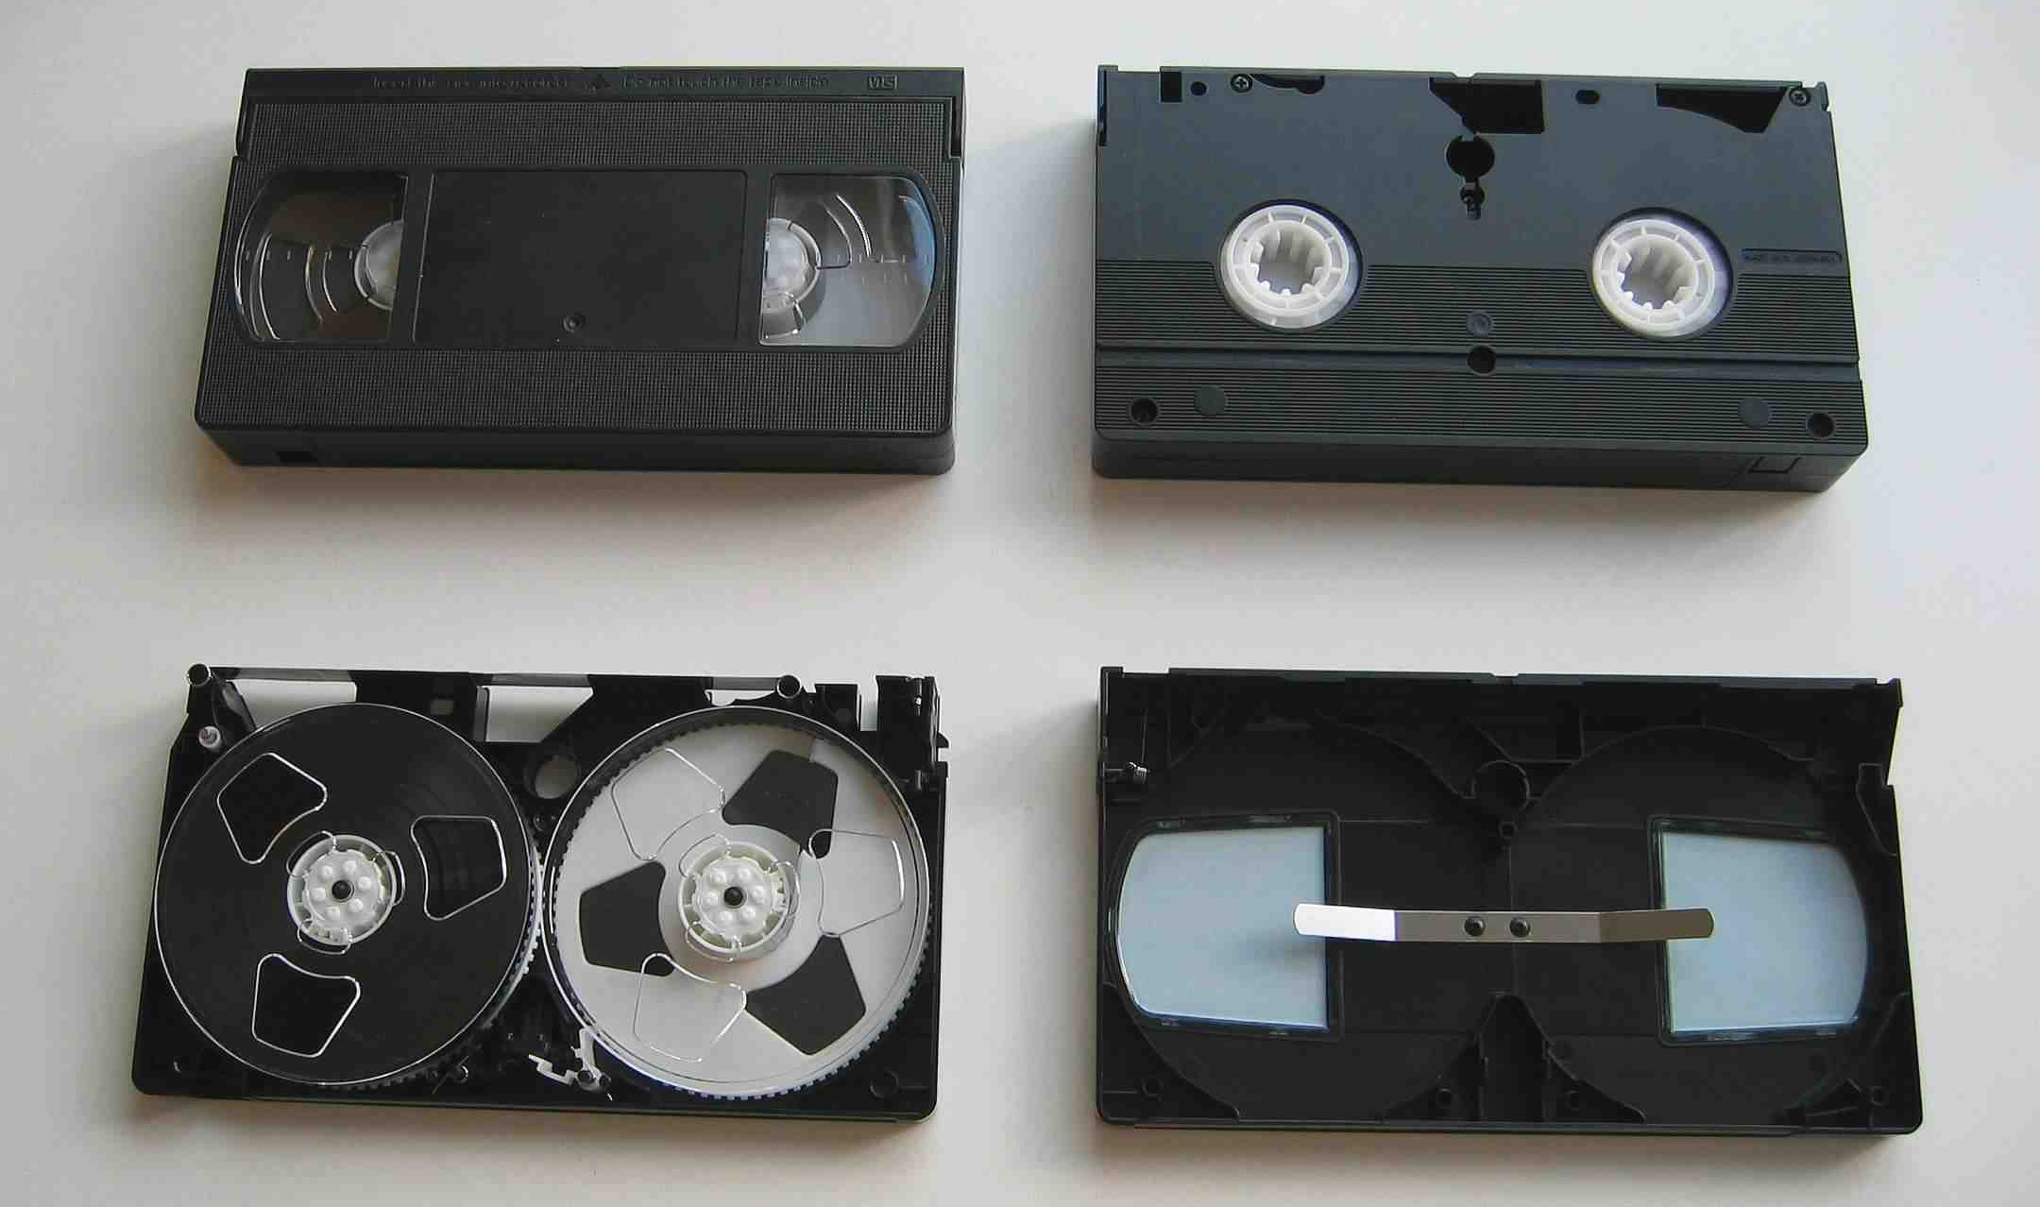
VHS
Fixed field changes
007 changes
$b = f (videocassette), $e = b (VHS), $g = h (videotape), $h = o (1/2 in.)
300 changes
$a = 1 videocassette, $c = 1/2 in.
338 changes
videocassette $b vf $2 rdacarrier
344 changes
$a = analog, $b = magnetic
346
$a = VHS, $b = [broadcast standard]
Notes:
A few things change when we catalog VHS tapes.

Slide 56
Streaming Video/ Video Files
Fixed field changes
007 changes dramatically
$a = c (electronic resource), $b = r (remote), $d = color content (coding varies), $e = n (no dimensions), $f = a (sound), $g = image bit depth (varies), $h = file format(s) (varies), $i = n (most likely choice), $j = antecedent (varies), $k = level of compression (varies), $l = reformatting quality (varies)
300 changes
$a = 1 online resource, $c = [leave blank]
337 changes
computer $b c $2 rdamedia
338 changes
online resource $b cr $2 rdacarrier
344 changes
$b = [leave blank]
347 changes
$b = [video encoding format], $c = [file size], $d = [resolution], $f = [encoded bitrate]
Notes:
When we catalog something like a video file or streaming video, we use a different set of codes in the 007 field and put a lot more information in the 347 field. Since there’s no physical carrier, we leave other things out.

Slide 57
Sources Consulted
LC. “RDA Record Examples.” http://www.loc.gov/catworkshop/RDA%20training%20materials /SCT%20RDA%20Records%20TG/
LC. “Value Lists for Codes and Controlled Vocabularies.” http://www.loc.gov/standards/valuelist/index.html
Maxwell, Robert L. Maxwell’s Handbook for RDA. Chicago: ALA Editions, 2013.
OCLC. “Bibliographic Formats and Standards.” http://www.oclc.org/bibformats/en.html
OLAC. “Best Practices for Cataloging DVD-Video and Blu-ray discs: Using RDA and MARC.” olacinc.org/drupal/capc_files/DVD_RDA_Guide.pdf
“RDA Toolkit.” http://access.rdatoolkit.org/

Slide 58
Cataloging Video Recordings in RDA Southeast Music Library Association October 20, 2016 Durham, NC
Dr. Sonia Archer-Capuzzo
smarcherdma@gmail.com

