Slide 1
Collection Development
A Music Library Association Educational Outreach Program Workshop
Lisa Hooper
lhooper1@tulane.edu
@lkHMusLibrarian

Slide 2
Identifying Patron Needs
Conservatory, school, or department?
Is focus on research, education, performance, or some combination of these?
If research focused, what level? (http://carnegieclassifications.iu.edu/classification_descriptions/basic.php)
In performance, is there one form or instrument that dominates?
Notes:
1. What?
Patron needs assessment is often thought of in direct correlation with collection assessment. In reality, we are assessing, or identifying, our patrons’ research, teaching, and learning needs. This means first finding out what your patrons are doing and what they’d like to be doing if they had the resources to support that work. After we know what our patrons need, we can look at our collections and assess whether our collections fulfill those needs in part or full.
2. When?
Generally, we end up doing different pieces of patron needs and collection assessment at different rates. We’ll talk about the different methods for patron needs assessment momentarily and you’ll quickly see why there are different rates.
3. Who?
We want to capture the current and anticipated needs of both our existing patrons and potential patrons. But before we can even think about actual people, we also need to think at the macro-level and think about our institution.
4. Slide
Once we have a broad, macro-level understanding of our institution, we can move to the micro-level of actual patron needs. To d this we can engage in both qualitative and quantative forms of assessment.

Slide 3
Identifying Patron Needs
Qualitative
Meet with faculty members (small groups, individually)
Patron surveys
Patron focus groups
Notes:
1. Slide
2. Qualitative Methods
In qualitative methods, you will obviously need to be prepared with questions. In faculty meetings, also be prepared with a couple prompt questions but let them do most of the talking. Some prompt questions may include:
What are you working on now?
If you know you have good resources for that topic, ask: I’m sure we have a few good resources for that, have you found everything you need or is there an angle to your research where you wish we had more?
If you know there aren’t any good resources or are unsure, ask: So what resources are you using then? How are you accessing them?
What’s your position on print versus electronic?
Is there ever a time you’d only want to use print?
Vice versa?
Why?
What qualities are you looking for in an electronic resource?
Any additional questions?
Follow through is important! After these discussions, look at your collections. If you find something relevant to you conversation partner’s research needs, send them a line. If you discover there’s a huge gap in the collections related to that research need, start looking to fill it and offer your conversation partner some alternatives in the meantime.
3. Benefits of Qualitative Methods:
Builds relationships and demonstrates your sincere interest as a partner in supporting teaching, learning, research, and performance.
Keeps you up to date with current needs
Identifies emerging collection needs
4. Limitations of Qualitative Methods:
Reflects current needs but does not anticipate future needs
Reveals the needs of a few, but are they the same as the silent majority?
Unless you actively recruit non-library users, qualitative information will reflect needs of current patrons but not potential library patrons

Slide 4
Identifying Patron Needs
Quantitative
Faculty publications
Review course descriptions and syllabi
Attend student performances
Review reference transactions
Review ILL requests
Review circulation statistics
Review purchase requests
Notes:
1. Quantitative Methods
Data-driven acquisition! What people relate in conversation may not necessarily be the same as their actions. Looking at the data also ensures you’re fulfilling the needs of your total patron population, not just the needs of a few vocal patrons.
2. Slide – Potential data source:
Faculty publications: specifically bibliographies in their recent publications
Review course descriptions, syllabi, and, if you can get them, lists of student research topics.
Attend student performances
Review reference transactions
Review ILL requests
Review circulation statistics: what ranges are seeing significant activity? This may be an area where keeping up with new publications may be important.
Review purchase requests
3. Benefits of Quantitative Methods:
Some activities (such as reviewing faculty publications and attending student performances) reveal needs of current and potential patrons
Ensures a broader, more inclusive picture of the needs of your current patrons.
4. Limitations of Quantitative Methods:
This is thankless work, i.e., you’re doing a lot of work on behalf of your constituents that they will never know about.
Extremely time consuming.
Will require synthesizing multiple data sets to get a complete picture (and this can be complicated).
Captures past needs, only intimates current needs, and fails to anticipate future needs.
5. Have any of you engaged in patron needs assessment? For what? How/Methodology? Lessons learned?
6. Questions?

Slide 5
Collection Development Policies
Why are they important?
Core qualities of a good policy.
What they should not be.
Notes:
What are they?
They are public statements that first briefly describe the key characteristics of the core target audience and then outline the broad parameters that guide collection development activity. These are largely, but not always, for internal audiences such as administrators and other librarians.
2. Why are they so important?
They clearly describe a library’s objectives in terms of collection development and access to information.
They define a library’s priorities and needs.
They promote communication between selectors and administrators.
They promote communication between a library and its users.
3. What are the core qualities of a good policy?
Reflective of the real needs of your constituents.
Reflective of the beliefs of your institution:
does your institution value open access resources,
does your institution promote digital resources,
does your institution support resources sharing and consortial buying/borrowing, etc.
Reflective off the realities of your institution:
Do space limitations lead your institution to greater focus on electronic resources
Do funding limitations impact your journal and/or database subscriptions
Flexible enough to capture the organically changing needs of your constituents.
4. They should not be:
Stagnant. Review your policy on a regular schedule. My reality means every three years. Your reality may suggest something else.
Thrown together quickly. These require significant review, study, and reflection. For most of us that means summer project.

Slide 6
Collection Development Policies
Components
Summary of your library, library mission
Define your collection’s primary user group or the disciplinary utility of the materials covered by your policy.
Purpose
Selection guidelines (language, learning level, publication date, formats, etc.)
What you do/don’t collect
Who collects for this subject
Notes:
1. Some institutions have overarching collection development guidelines that may prescriptively spell out the components you should include in your collection development policy. The elements up here are somewhat generalized and common to most policies.
2. Slide

Slide 7
Collection Development Policies
Activity!
University of North Texas Music Library
http://www.library.unt.edu/policies/collection-development/music-library-collection-development-policy
Vanderbilt Anne Potter Wilson Music Library
http://www.library.vanderbilt.edu/music/coll_dev.php
Tulane University
http://library.tulane.edu/about/collections/policies/music
Dartmouth College
https://www.dartmouth.edu/~library/collprog/cdp/musiccdp.html
Notes:
Activity
In groups of 2-3, review the policy and think about it in terms of what we just talked about. Be prepared to briefly describe the program the policy supports as well as the policy’s strengths and weaknesses.

Slide 8
Vendors & Orders
Who are they? What are they?
Vendors:
JW Pepper
Theodore Front
Harrassowitz
Puvill
Music Hunter
AC/AV Source
Theadore Front
Order Types:
Firm Orders
Standing Orders
Approval Plans
Notes:
1. Who are they?
You’ll want to go to different vendors for different needs. You’ll quickly learn through experience which vendors to go to for what. A good example, though, would be a vendor for imprints from Spain. If you have a collecting need in this area, then Puvill is the place to go. If you need musical theater selections, my preferred go to is JW Pepper. Every once in a while you’ll find a European imprint that you can only get from a European vendor, go to Harrassowitz for those. Everything else I go to Theodore Front for. Every once in a while I get a request for an obscure score, that’s when I might contact a music store such as Yesterday Service and ask them to do the hard work for me.
CDs and DVDs are much easier to come by. Amazon, occasionally CD Baby are my go to sources. There are also specialized vendors who have added services that you can’t get from these online box shops. They include:
Music Hunter – Jay will do everything in his power to match prices and make the purchasing process easy for you.
AC/AV Source – able to provide MARC records.
Theodore Front – able to provide MARC records.
All three have flexible payment options.
I see a huge benefit in diversification and competition so I try to order recordings at least from a variety of sources. That said, part of vendor selection is also closely tied to the needs of your acquisitions department and this may limit your vendor choices.
2. Slide

Slide 9
Orders
Firm Orders
An order of a specific title in a specific format intentionally placed by a collection developer (or an acquisitions member on behalf of the collection developer) with a specified vendor.
Alt text = discretionary spending/buying
Alt text = micro-purchasing
Notes:
Definition
Alternative names

Slide 10
Orders
Firm Orders - Selecting
Selection Decision Factors:
Was it requested
Does it provide an advancement of thought in a core musical topic?
Does it fulfill a direct research, teaching, learning, or performing need among your constituents
If you purchase a score, do you also need to purchase a recording?
Does it fulfill a direct anticipated need of your constituents?
Cost? Is it cost prohibitive.
Other considerations?
Notes:
1. Slide/Selection Decision Factors:
Was it requested – in some institutions with limited budgets and/or expertise, this is the only deciding factor. Any thoughts on why this might be problematic? (A: typically only a small subset of faculty actively make any selection decisions and typically those decision focus heavily or entirely on materials in their researcher/performance areas. This leads to an extremely unbalanced collection which can be costly to correct at a future date as faculty membership changes.)
Does it provide an…
Does it fulfill…
If you purchase a score, do you also need to purchase a recording? Is a recording even available?
Does it fulfoll…
Cost? Is it cost prohibitive? What’s your ceiling? Is there a dollar amount that you refuse to spend out of your regular budget on a single item? If so, is it a candidate for year end “big ticket” spending?

Slide 11
Orders
Firm Orders - Selecting
Review Sources:
Choice Reviews – books
YBP - books
Notes – all formats
Fontes Artis – all formats
Basic Music Library (BML) – all formats
Gramophone – recordings
Fanfare – recordings
Black Grooves (www.blackgrooves.org) – recordings
Notes:
Slide
Bias
In all review sources but particularly in Gramophone and Fanfare, beware of bias! Gramophone seems to focus on a handful of record labels. A book of essays originally printed by the founder and main editor of Fanfare was recently published; shockingly biased against any genre that is not classical, the popularization of classical music, and people who don’t naturally appreciate classical music. For that reason alone it’s good to have a few other sources to turn to.

Slide 12
Orders
Firm Orders – What it might look like
Let’s look at examples!
Notes:
1. Before you start ordering, schedule a meeting with your acquisitions team! Talk with them about what information they need for each order and what format or formats work best for them.
2. Printed screenshot examples of a score, DVD, and book order were provided.
3. If you look closely at the score order, you’ll see some key information, such as format, publisher number, OCLC number. Let’s digress just a little bit and talk about some of the things that might make ordering music difficult.

Slide 13
Orders - A brief but related digression
Formats
What are they?
Notes:
1. Slide
2. So you need to know what format you need for your collection, you need to ensure the record you found in the vendor catalog is for the correct format, and you need to convey that format information to your acquisitions team or whomever will actually be placing the order.

Slide 14
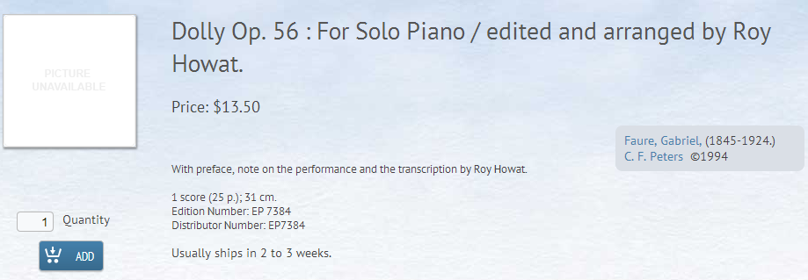
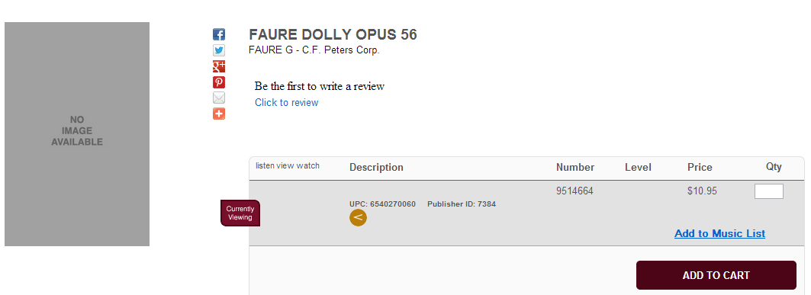
Orders - A brief but related digression
Vendor catalog records
Notes:
Here are two different vendor records. What are some of the differences? Similarities? How can you tell if these are the same score? What do these differences mean for searching for and locating materials in different online vendor catalogs? What do these differences mean for how you communicate with your acquisitions team?

Slide 15
Orders - A brief but related digression
Naming conventions
In music it’s not uncommon to recognize a work by multiple names. For example:
Concerto no. 9 in E-flat major for piano
Piano concerto no. 9, K. 271 in E-flat major
Klavierkonzert nr. 9 Es-dur, KV 271
Konzert in Es fur Klavier und Orchestra KV. 271
Jeunehomme

Slide 16
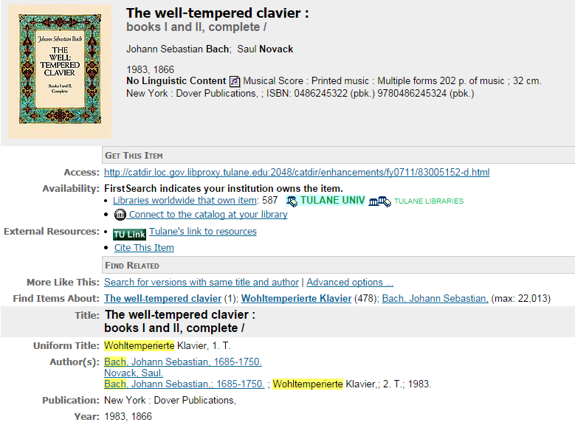
Orders - A brief but related digression
Naming conventions
Notes:
Many cases can be solved by searching vendor catalogues by uniform title. In the case of The Well-Tempered Clavier, you can use the uniform title Wohltemperierte Klavier and be pretty comfortable in the thoroughness of your search results.

Slide 17
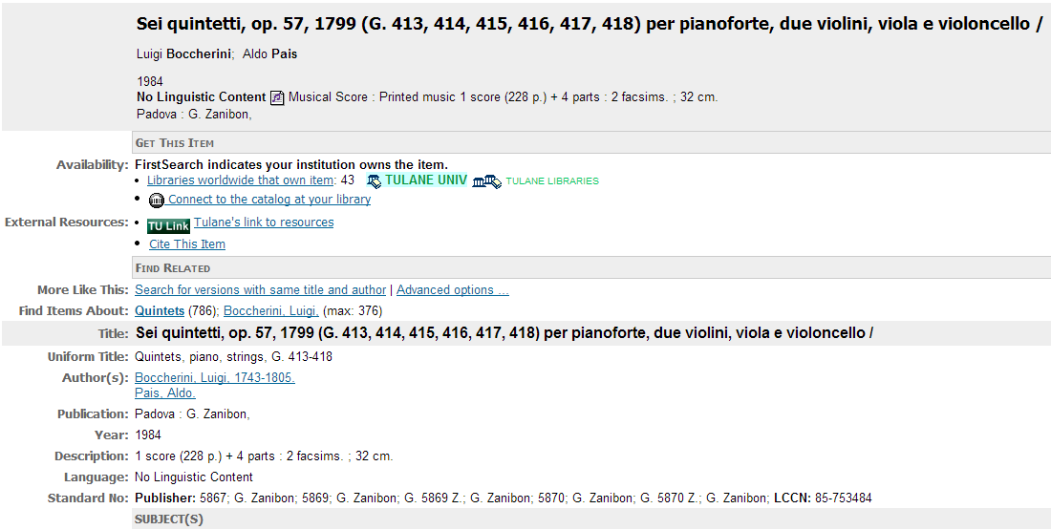
Orders - A brief but related digression
Naming conventions
Go to www.tfront.com and www.jwpepper.com – can you find it?
Notes:
1. The fallback on uniform titles is, however, not always an option as exhibited by the rather non-descript uniform title displayed here. Sometimes you have to get creative with your searching, calling on publisher names, publisher numbers, opus numbers, or even catalog numbers.
2. Let’s be sure we all know where to find the key descriptive pieces of information in an OCLC/worldcat record. Find the author, editor, title, publication location and year, and, finally, the description.
3. So let’s try finding a vendor for this score. Try going to www.tfront.com and www.jwpepper.com. Can you find it?

Slide 18
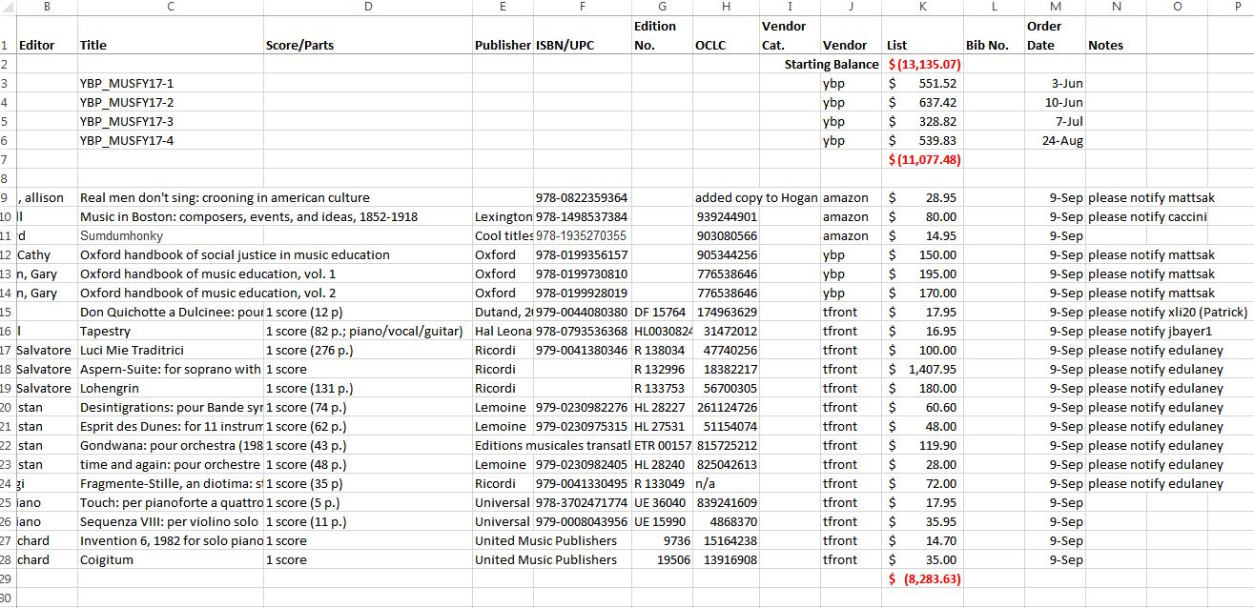
Orders
Firm Orders – Keeping track
Notes:
1. This is a sample record of books and scores ordered during fiscal year 17 (or FY17) up to September 9, 2016 (NOTE: can you find the error in price listing here? Simple mistakes like this can really throw you off!). You may notice that I don’t list books by title if I purchased them via YBP Gobi, instead in the title column I’ve listed the file name I created for a pdf listing of all books in a single order placed via YBP.
2. Keeping track of what you order is vitally important:
It gives you a record to refer to if you have to answer questions from acquisitions
It gives you a checklist to refer to as you ensure all of your orders were actually placed
If it was ordered for someone and the notification note gets dropped along the way, you can easily go back to your records and find out who it was for
It ensures you don’t over spend your budget

Slide 19
Orders
Firm Orders – Keeping track
Screenshot of Voyager Acquisitions module removed due to licensing restrictions.
Notes:
1. Even though you can use this master purchase list to keep track of your budget, you should keep in mind that that it’s a rough guide. The prices we get at the time of purchase may be different than the prices you saw when you first identified the item. Always periodically check your budget in your acquisitions ILS module. If you see a major discrepancy (generally more than $500) in your available balance, that’s when you know you need to go back through your order list and find out what got missed.
2. Any questions about firm orders?

Slide 20
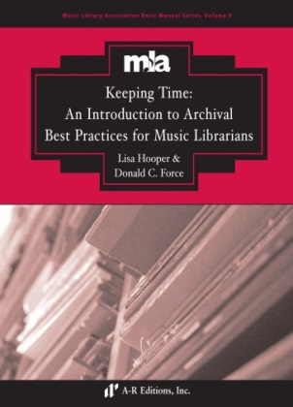
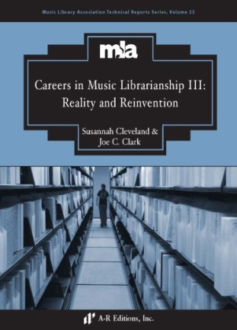
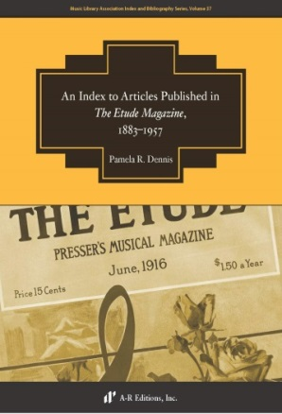
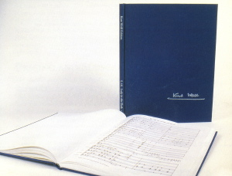
Orders
Standing Orders
An order with a vendor or publisher for a series. Each volume of the series is sent automatically as it becomes available and is billed when shipped.
Complete Works
Notes:
1. Slide
2. You can use standing orders for books series (such as the MLA Basic Manual Series), for scores (such as major composer complete works that are typically released one expensive volume at a time), for record labels (such as Archeophone or Dust to Digital), or by major ratings lists (such as Billboard 100 or the Gramophone Recommends albums.

Slide 21
Orders
Standing Orders - Selecting
Selection Decision Factors:
Was the series requested
Does the series significantly contribute to meeting the current needs of your constituents
Does the series have the potential to significantly contribute to meeting the anticipated future needs of your constituents
Would it be cost prohibitive to purchase it as a set at a future date
Notes:
1. Slide
2. Questions or thoughts about standing orders?

Slide 22
Orders
Approval Plans
Plans outlining parameters a specified vendor is to use to select and ship materials to your library. Traditionally, the receiving library would review and “approve” the materials before accepting them, unwanted materials would be returned to the vendor. This approval phase occurs less and less, thus necessitating clear and thorough selection guidelines and regular monitoring.

Slide 23
Orders
Approval Plans- what they are
A method to ensure the acquisition of core learning, teaching, research, and performance material
A method to streamline the acquisitions process
A method to direct your time, attention, and energy toward identifying unique yet significant material for your collection

Slide 24
Orders
Approval Plans- what they are not
A method to save significant amounts of time
A method to fulfill all your collecting needs
A method to fill in the gaps or compensate for your own limited knowledge
Notes:
It takes a lot of time! Time to research, set up, monitor, and revise!
Each university has unique teaching, learning, and research needs along with the standard. The plan may take care of the standard but it’s up to you to take care of the unique.
Plans collect current materials, they will not retrospectively fill an information gap, you have to do that. No matter how specific you are in your plan, they still won’t be able to accurately fulfill the unique needs of your institution unless you have at the very least a basic understanding of the field.

Slide 25
Orders
Approval Plans- when to use one
When you have a thorough understanding of your collection and collecting needs
When you have a clear understanding of your spending habits
When you have funds to support both continued discretionary (i.e., firm orders) spending and an approval plan

Slide 26
Orders
Approval Plans- setting it up
Activity!
http://www.tfront.com/t-ApprovalPlansHome.aspx
Notes:
Activity – ask them to draft an approval plan based on provided description of Tulane Music Department needs

Slide 27
Orders
Approval Plans- monitoring the plan
Vitally important to ensuring:
Materials coming in meet approval plan criteria
Firm orders do not duplicate approval orders
Vendor remains within budget

Slide 28
Orders
Approval Plans- assessing the plan
Qualitative –
Patron feedback
Quantitative –
Usage statistics
Notes:
Qualitative: patron feedback (how do you elicit this feedback?)
Quantitative: usage stats are not without their problems

Slide 29
Orders
Approval Plans- for more thoughts
For more thoughts, check out this forthcoming article:
Hooper, Lisa. “The Art of Crafting Music Score Approval Plans: An Ongoing Process.” Collection Management 41/4 – forthcoming.
Notes:
Qualitative: patron feedback (how do you elicit this feedback?)
Quantitative: usage stats are not without their problems

Slide 30
Additional Readings
Berndt Morris, Elizabeth. “Building a Collection in Electronic Music: Considerations and Sources.” Music Reference Services Quarterly 15/1 (Jan/Mar 2012): 34-40.
Luttmann, Stephen. “Selection of Music Materials,” Selecting Materials for Library Collections. Audrey Fenner, editor. Binghamton, NY: Haworth Information Press, 2004.
Fling, Michael. Guide to Developing a Library Music Collection. Chicago: American Library Association, 2008.
____. “Tips on Acquiring Music.” Notes: Quarterly Journal of the Music Library Association 63/2 (Dec 2006): 279-288.
Hooper, Lisa. “And We’re Back! Experiences in Quickly Building a Robust Sound Recording Collection.” Music Reference Services Quarterly 15/3 (Jul 2012): 173-179.
Maple, Amanda and Jean Morrow. Guide to Writing Collection Development Policies for Music. Music Library Association Technical Reports, 26. Lanham, MD: Scarecrow, for the Music Library Association, 2001.
Smith, Shelley. “Weeding Considerations for an Academic Music Library.” Music Reference Services Quarterly 15/1 (Jan 2012): 22-33.
Zager, Daniel. “Essential Partners in Collection Development: Vendors and Music Librarians.” Notes: Quarterly Journal of the Music Library Association 63:3 (Mar 2007): 565-575.

